Slide 1
Faculty Welcome &
Academic year Kickoff
Where Free Minds Flourish
September 3, 2026

Slide 2
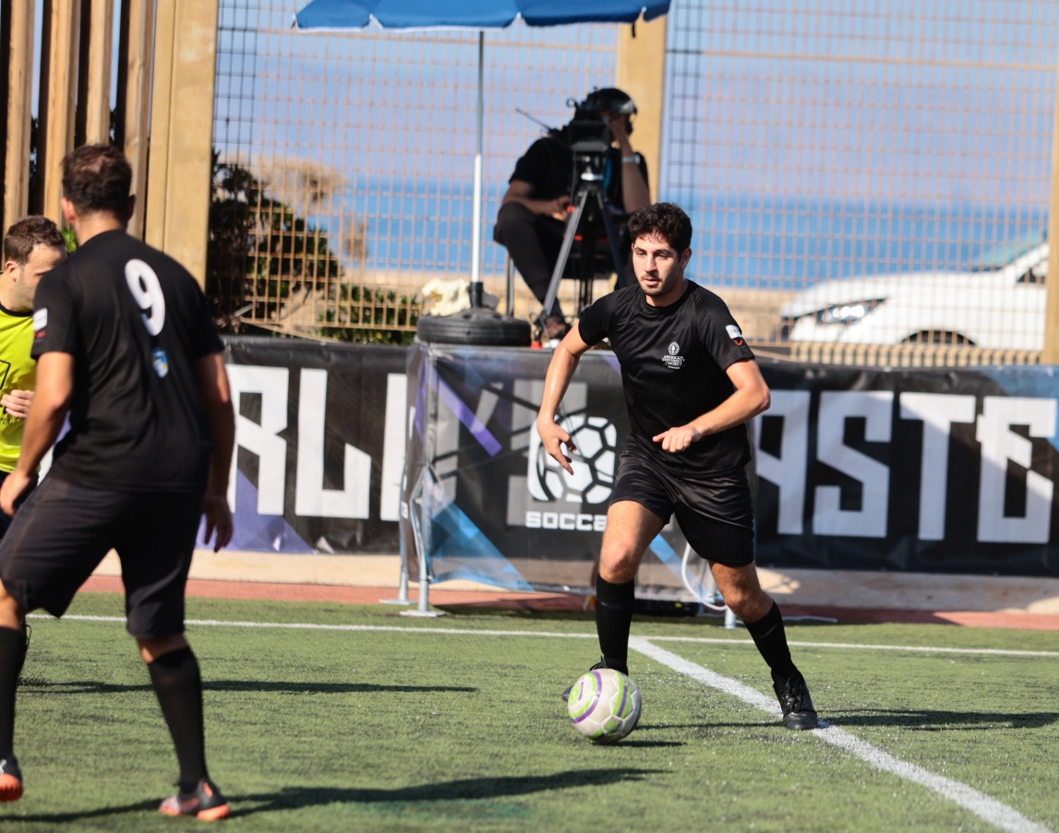
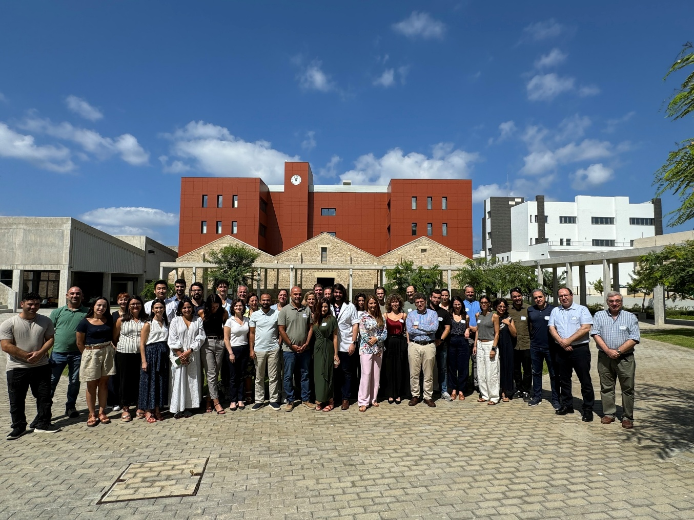
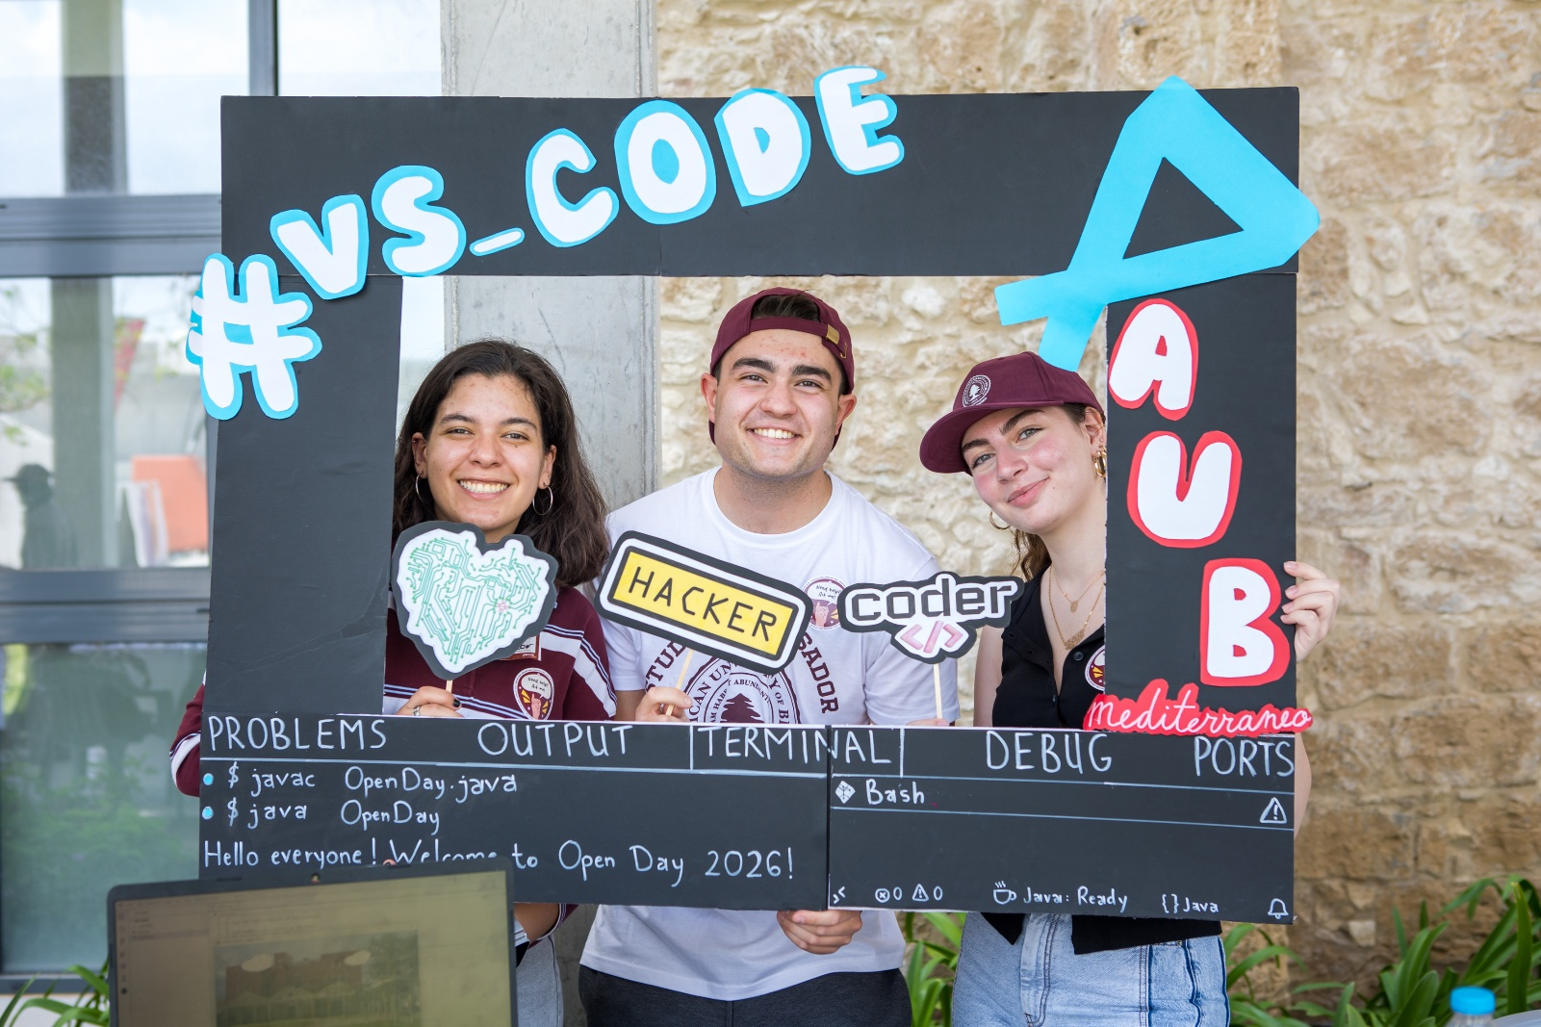
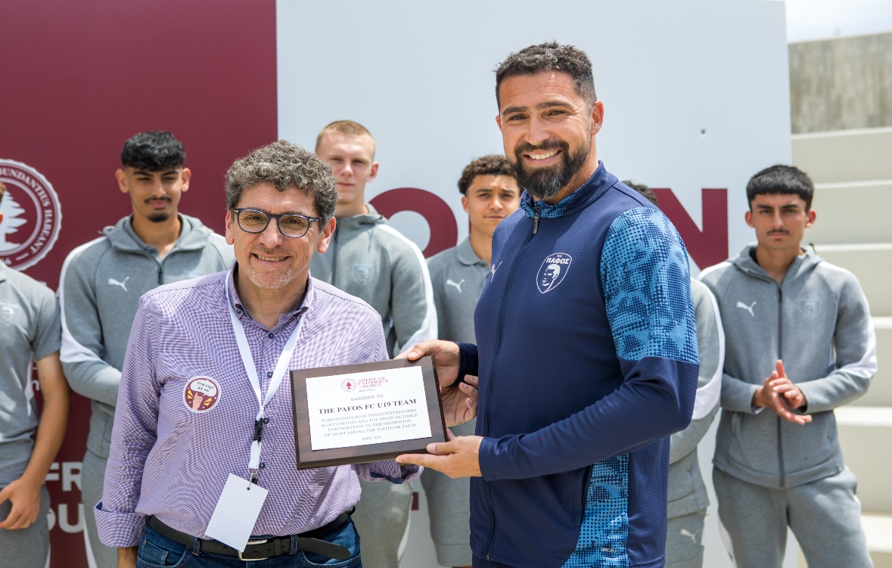
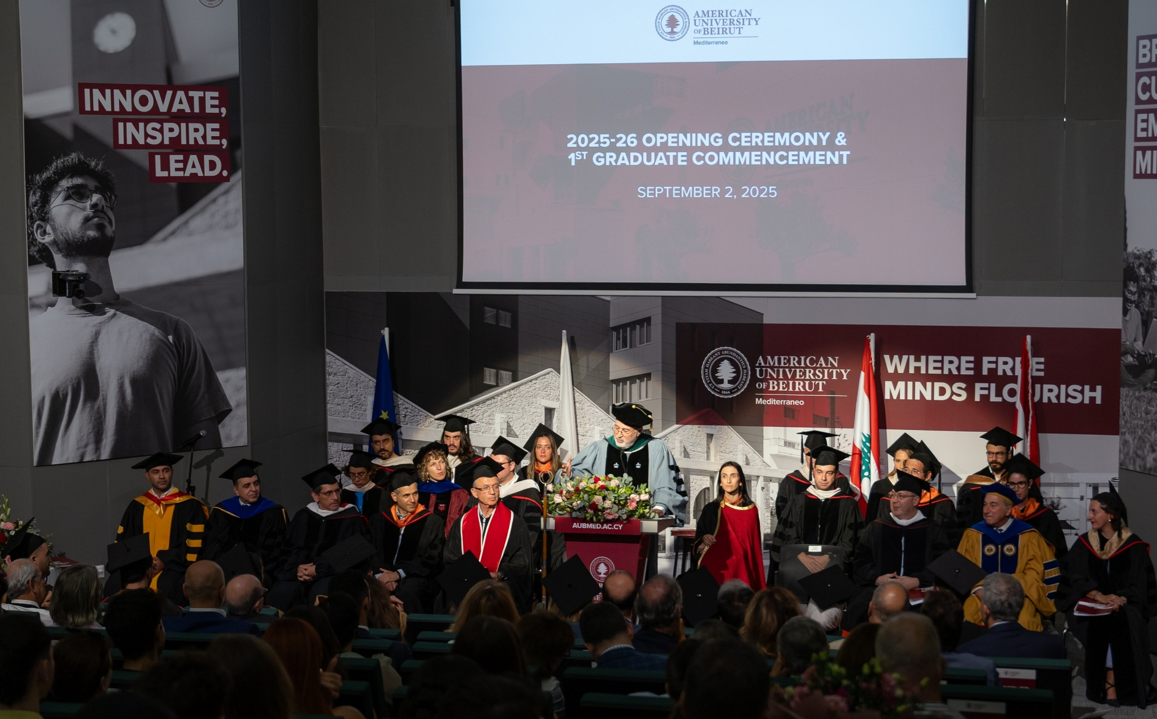
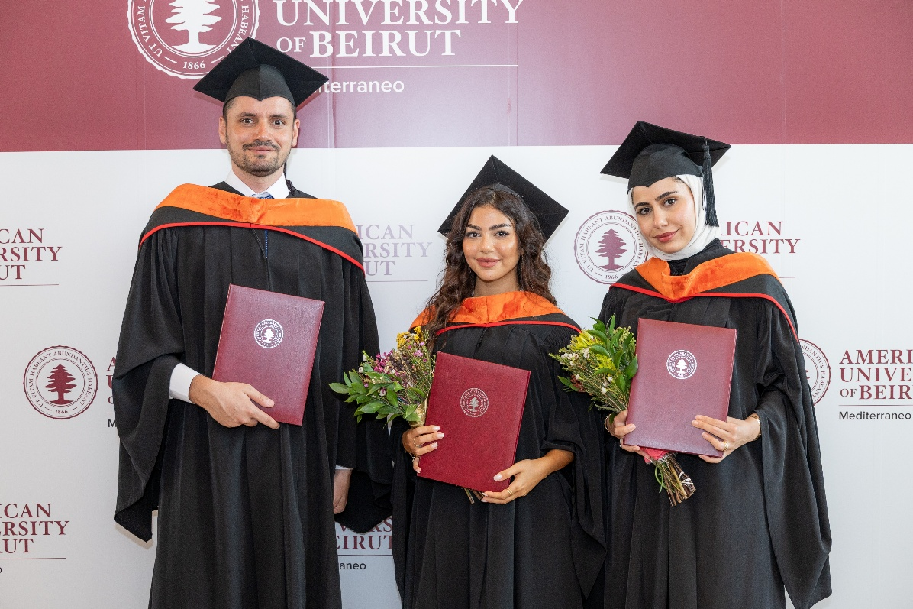
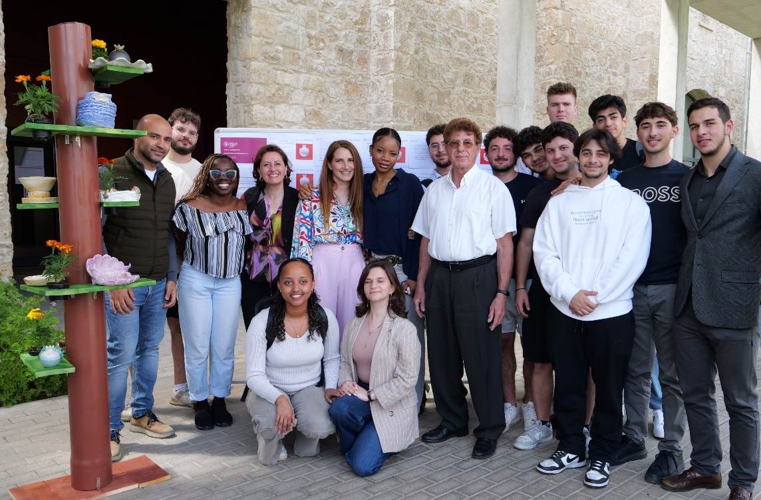
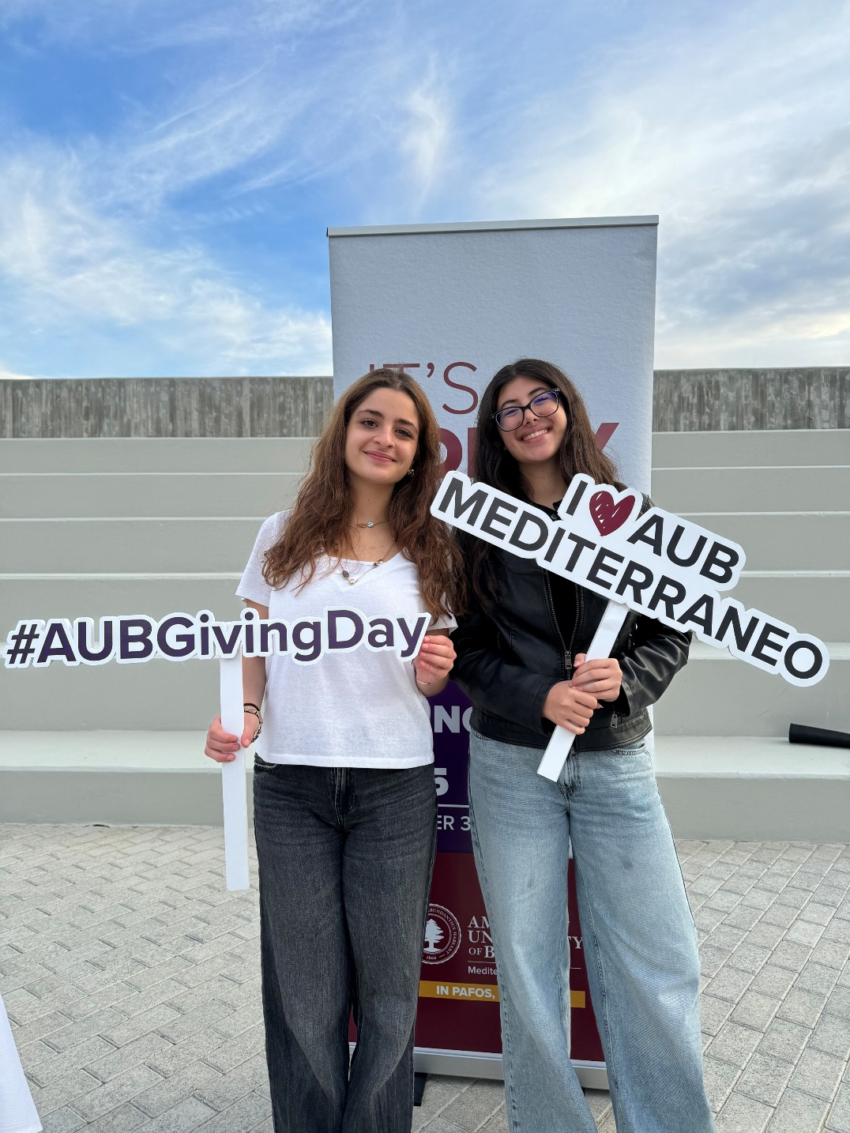
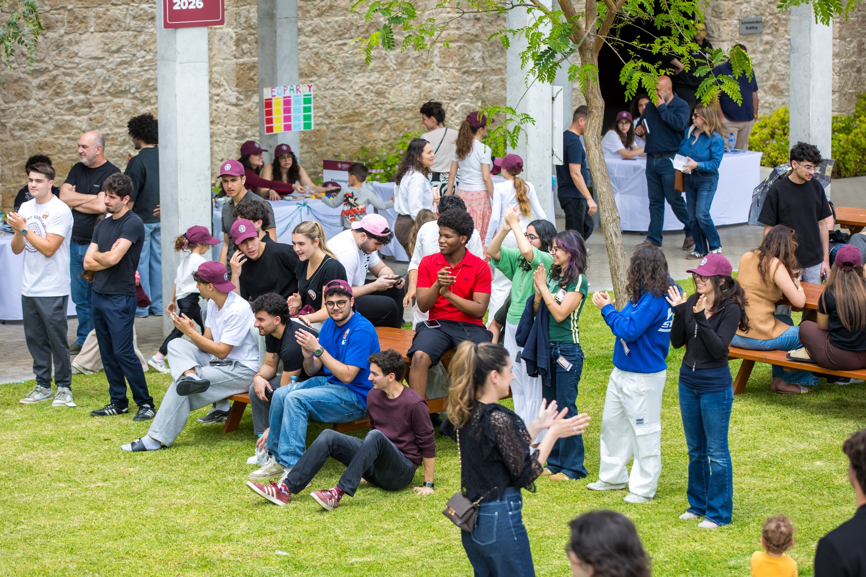
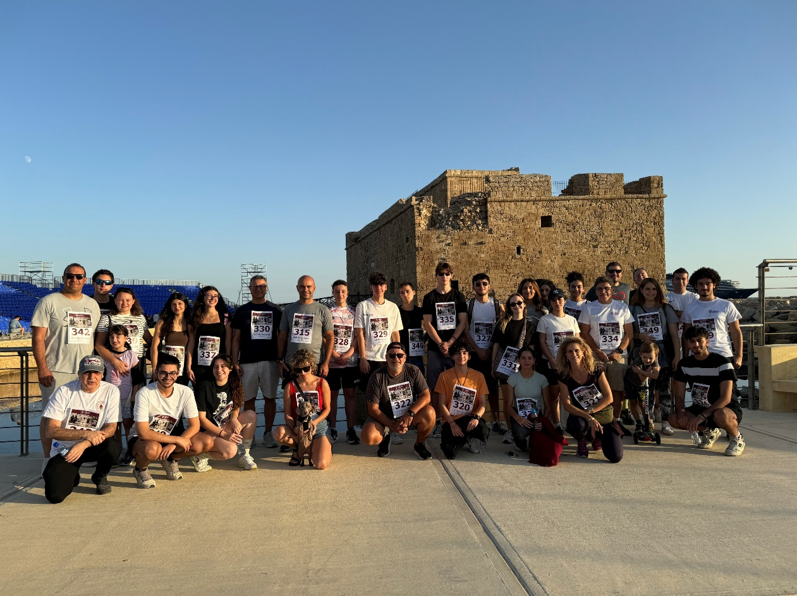
  Beginning the Year Together
  A new academic year is a chance to reconnect, welcome new colleagues, and look ahead together.

Slide 3
Faculty Welcome & Academic Year Kickoff
Today’s
main topics:
01.
04.
Who We Are
How We Contribute
02.
05.
Where We Are
How We Build Our Community
03.
06.
Where We Are Going
What You Need to Know

Slide 4
Faculty Welcome & Academic Year Kickoff
WHO WE ARE
American University of Beirut
AUB Mediterraneo
Our Opportunity
Founded 1866 | Beirut, Lebanon
Independent, not-for-profit university
American liberal arts educational tradition
Accredited by MSCHE
Programs registered with NYSED
~8,200 students, 141 programs, 758 faculty
78,000 alumni in 120 countries
QS 2027 World Ranking #223
Global research, alumni and institutional network
Established 2023 | Pafos, Cyprus
AUB's first campus outside Lebanon
Part of AUB's global expansion
American liberal arts educational model
Licensed by CYQAA
Programs registered with NYSED
Connected to AUB's MSCHE accreditation framework
We are small. We are growing. We are building.
SMALL: We can know our students and colleagues well.
GROWING: We have new programs, new colleagues, new students and new possibilities.
BUILDING: Many of the structures, traditions, and practices of the institution are being created now. Every faculty member has a direct role in shaping the university.
One AUB tradition. A new Mediterranean campus. A shared commitment to academic excellence.

Slide 5
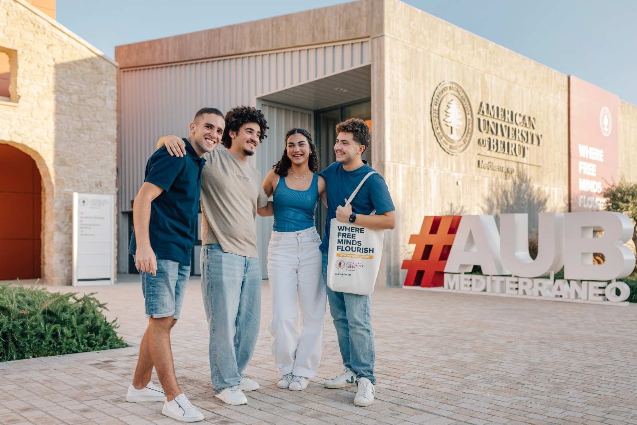
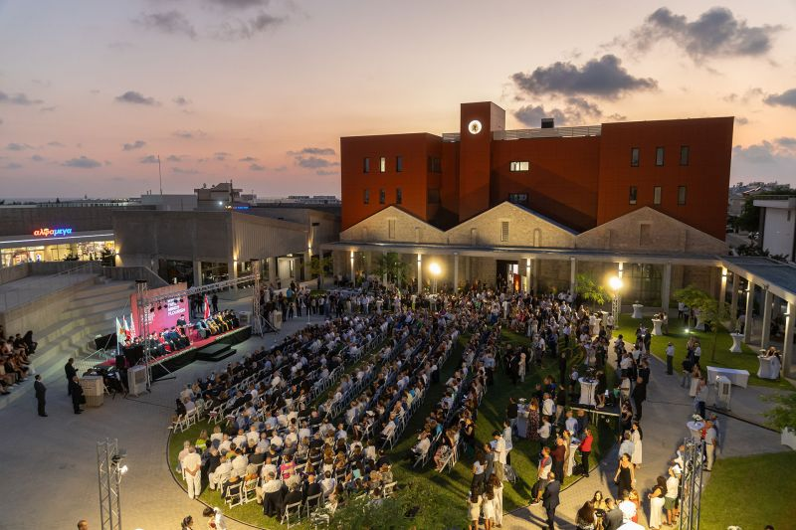
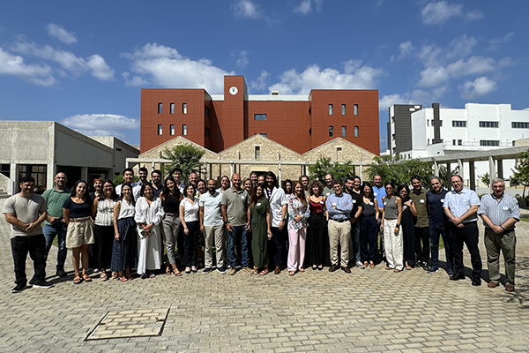
Faculty Welcome & Academic Year Kickoff
A Young Campus, A Growing Community:
2023
2024–25
2025–26
2026–27
First students
First cohort
Campus launched
First degrees
New campus buildings
Faculty & staff growth
~250 students
8 programs
Growing research & partnerships
~150 new students
16 new faculty
2 new programs
New opportunities!

Slide 6
Faculty Welcome & Academic Year Kickoff
Our Growing University community Today
~400
40+
50+
10
3
Students
nationalities
faculty
Undergraduate & graduate programs
years since
opening
We are small enough to know one another.
And we are growing enough to create new possibilities.

Slide 7
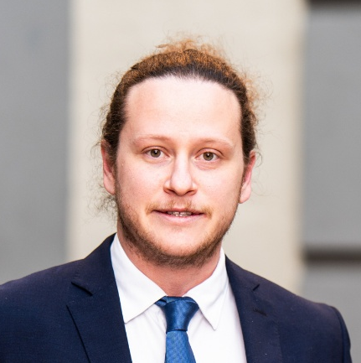
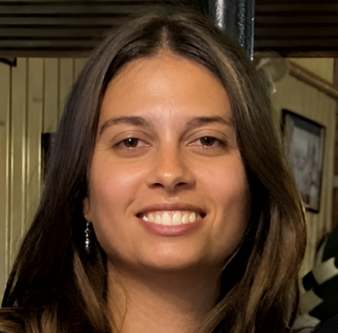
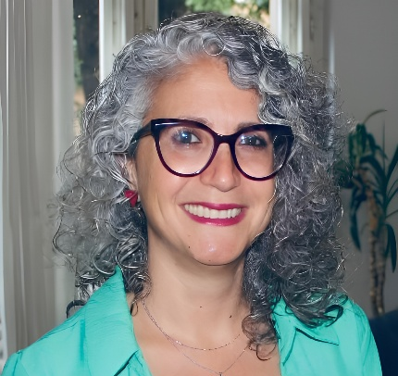
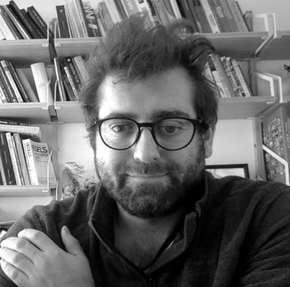
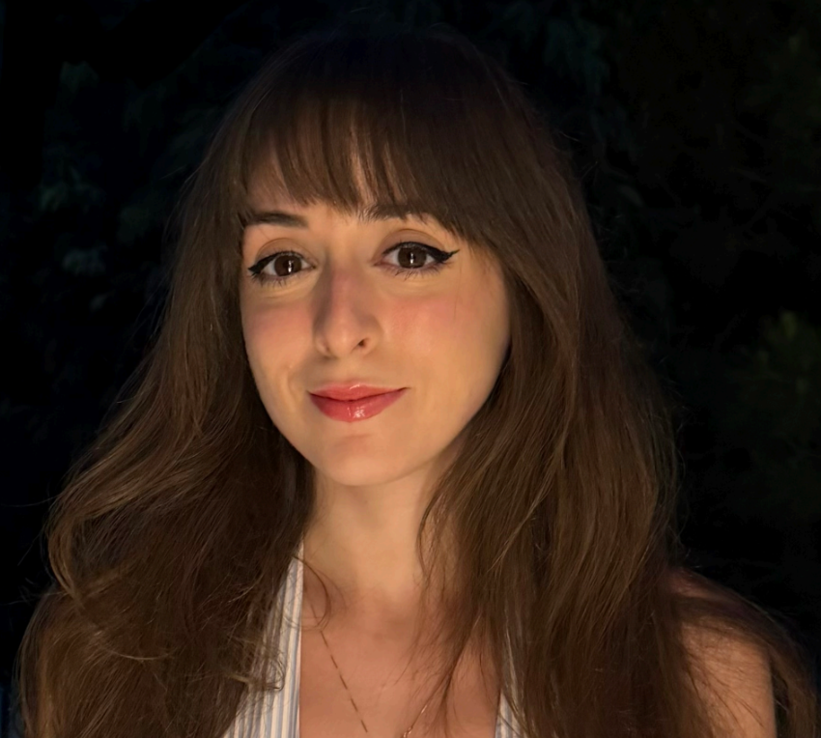
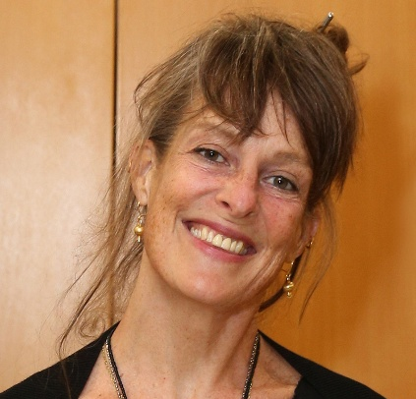
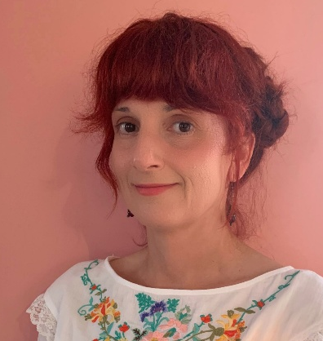
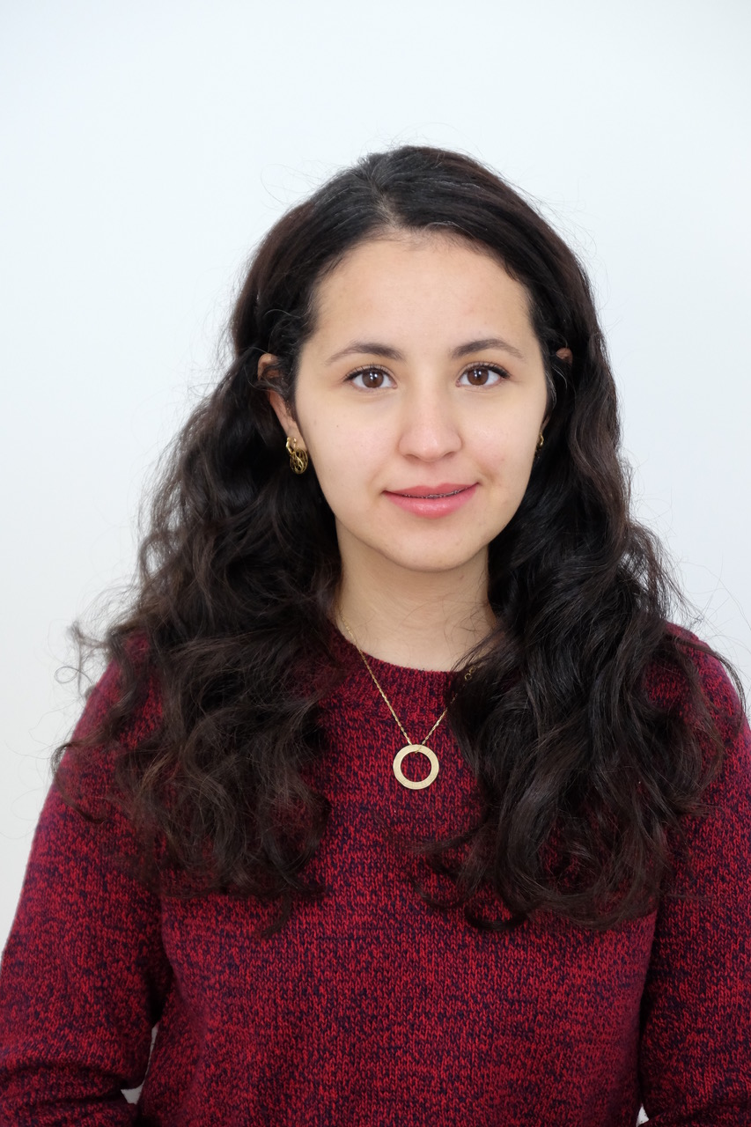
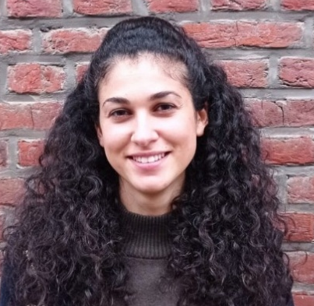
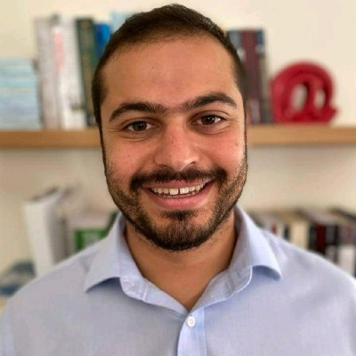
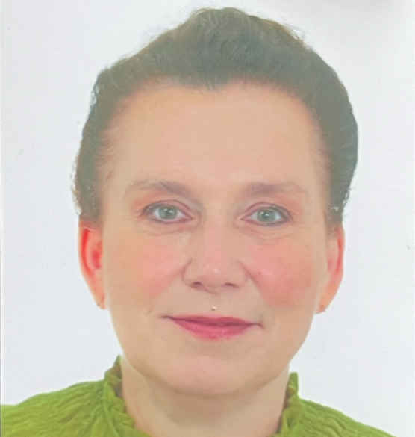
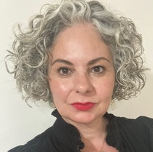
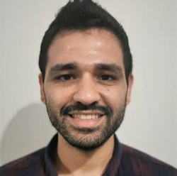
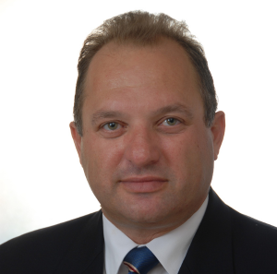
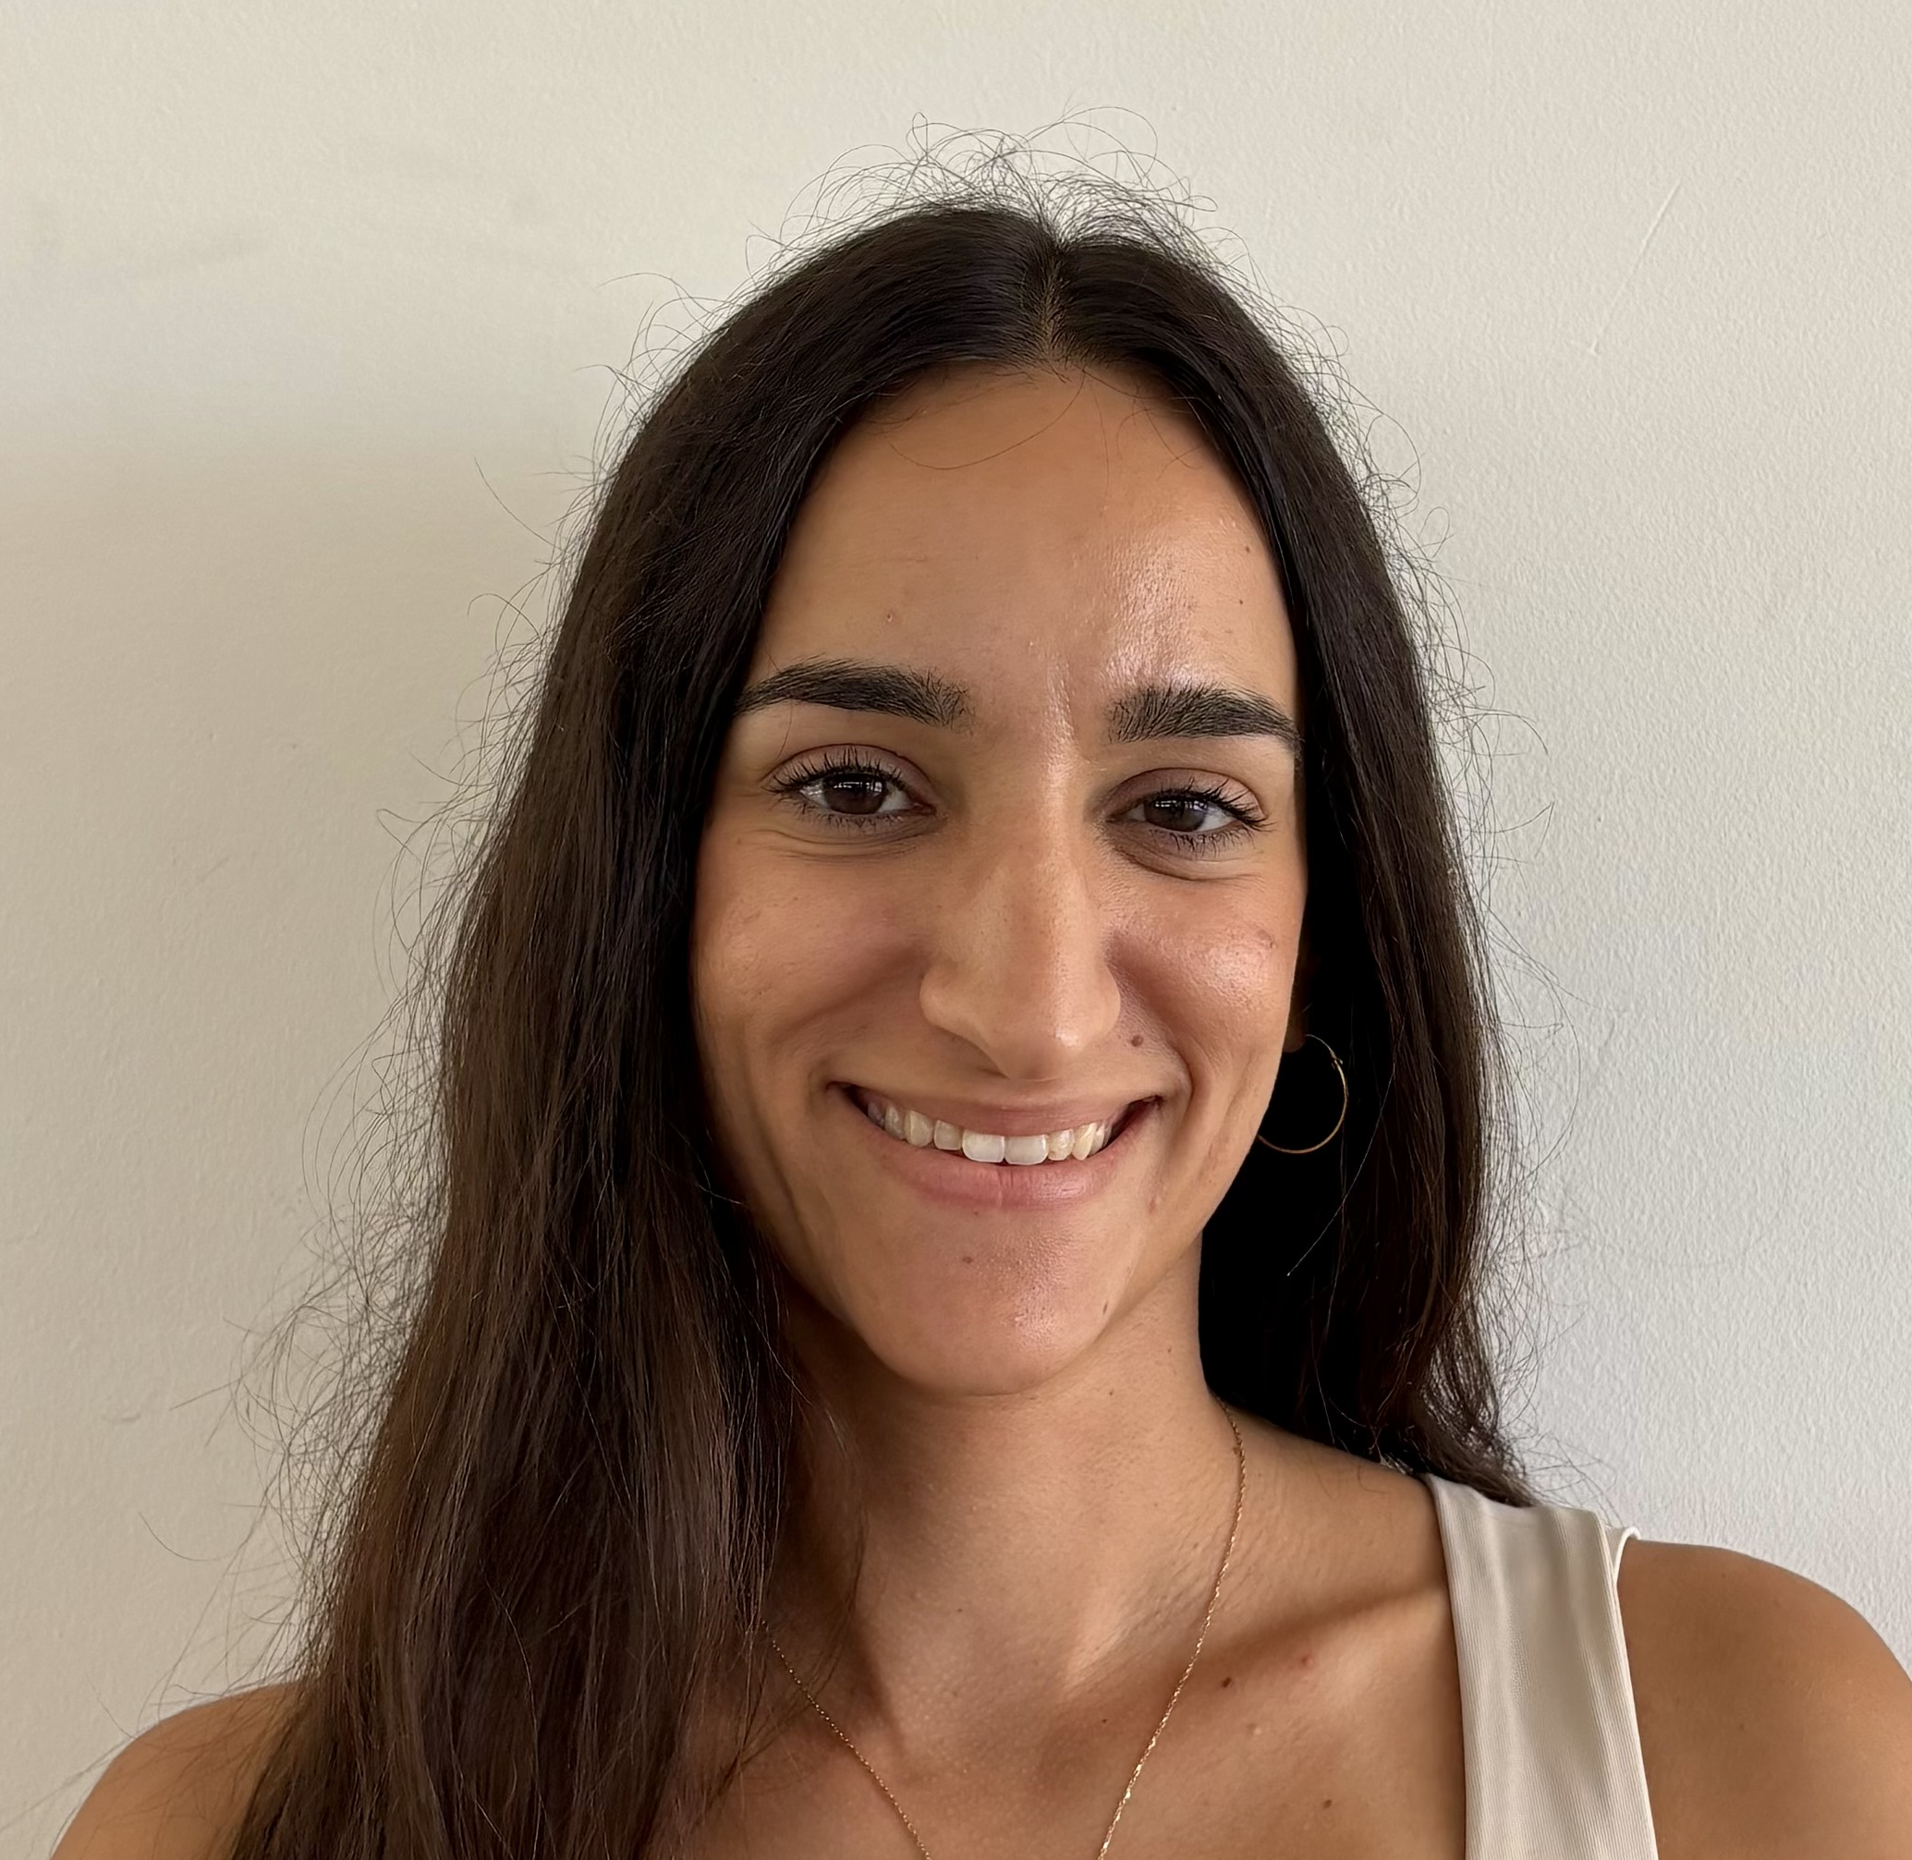
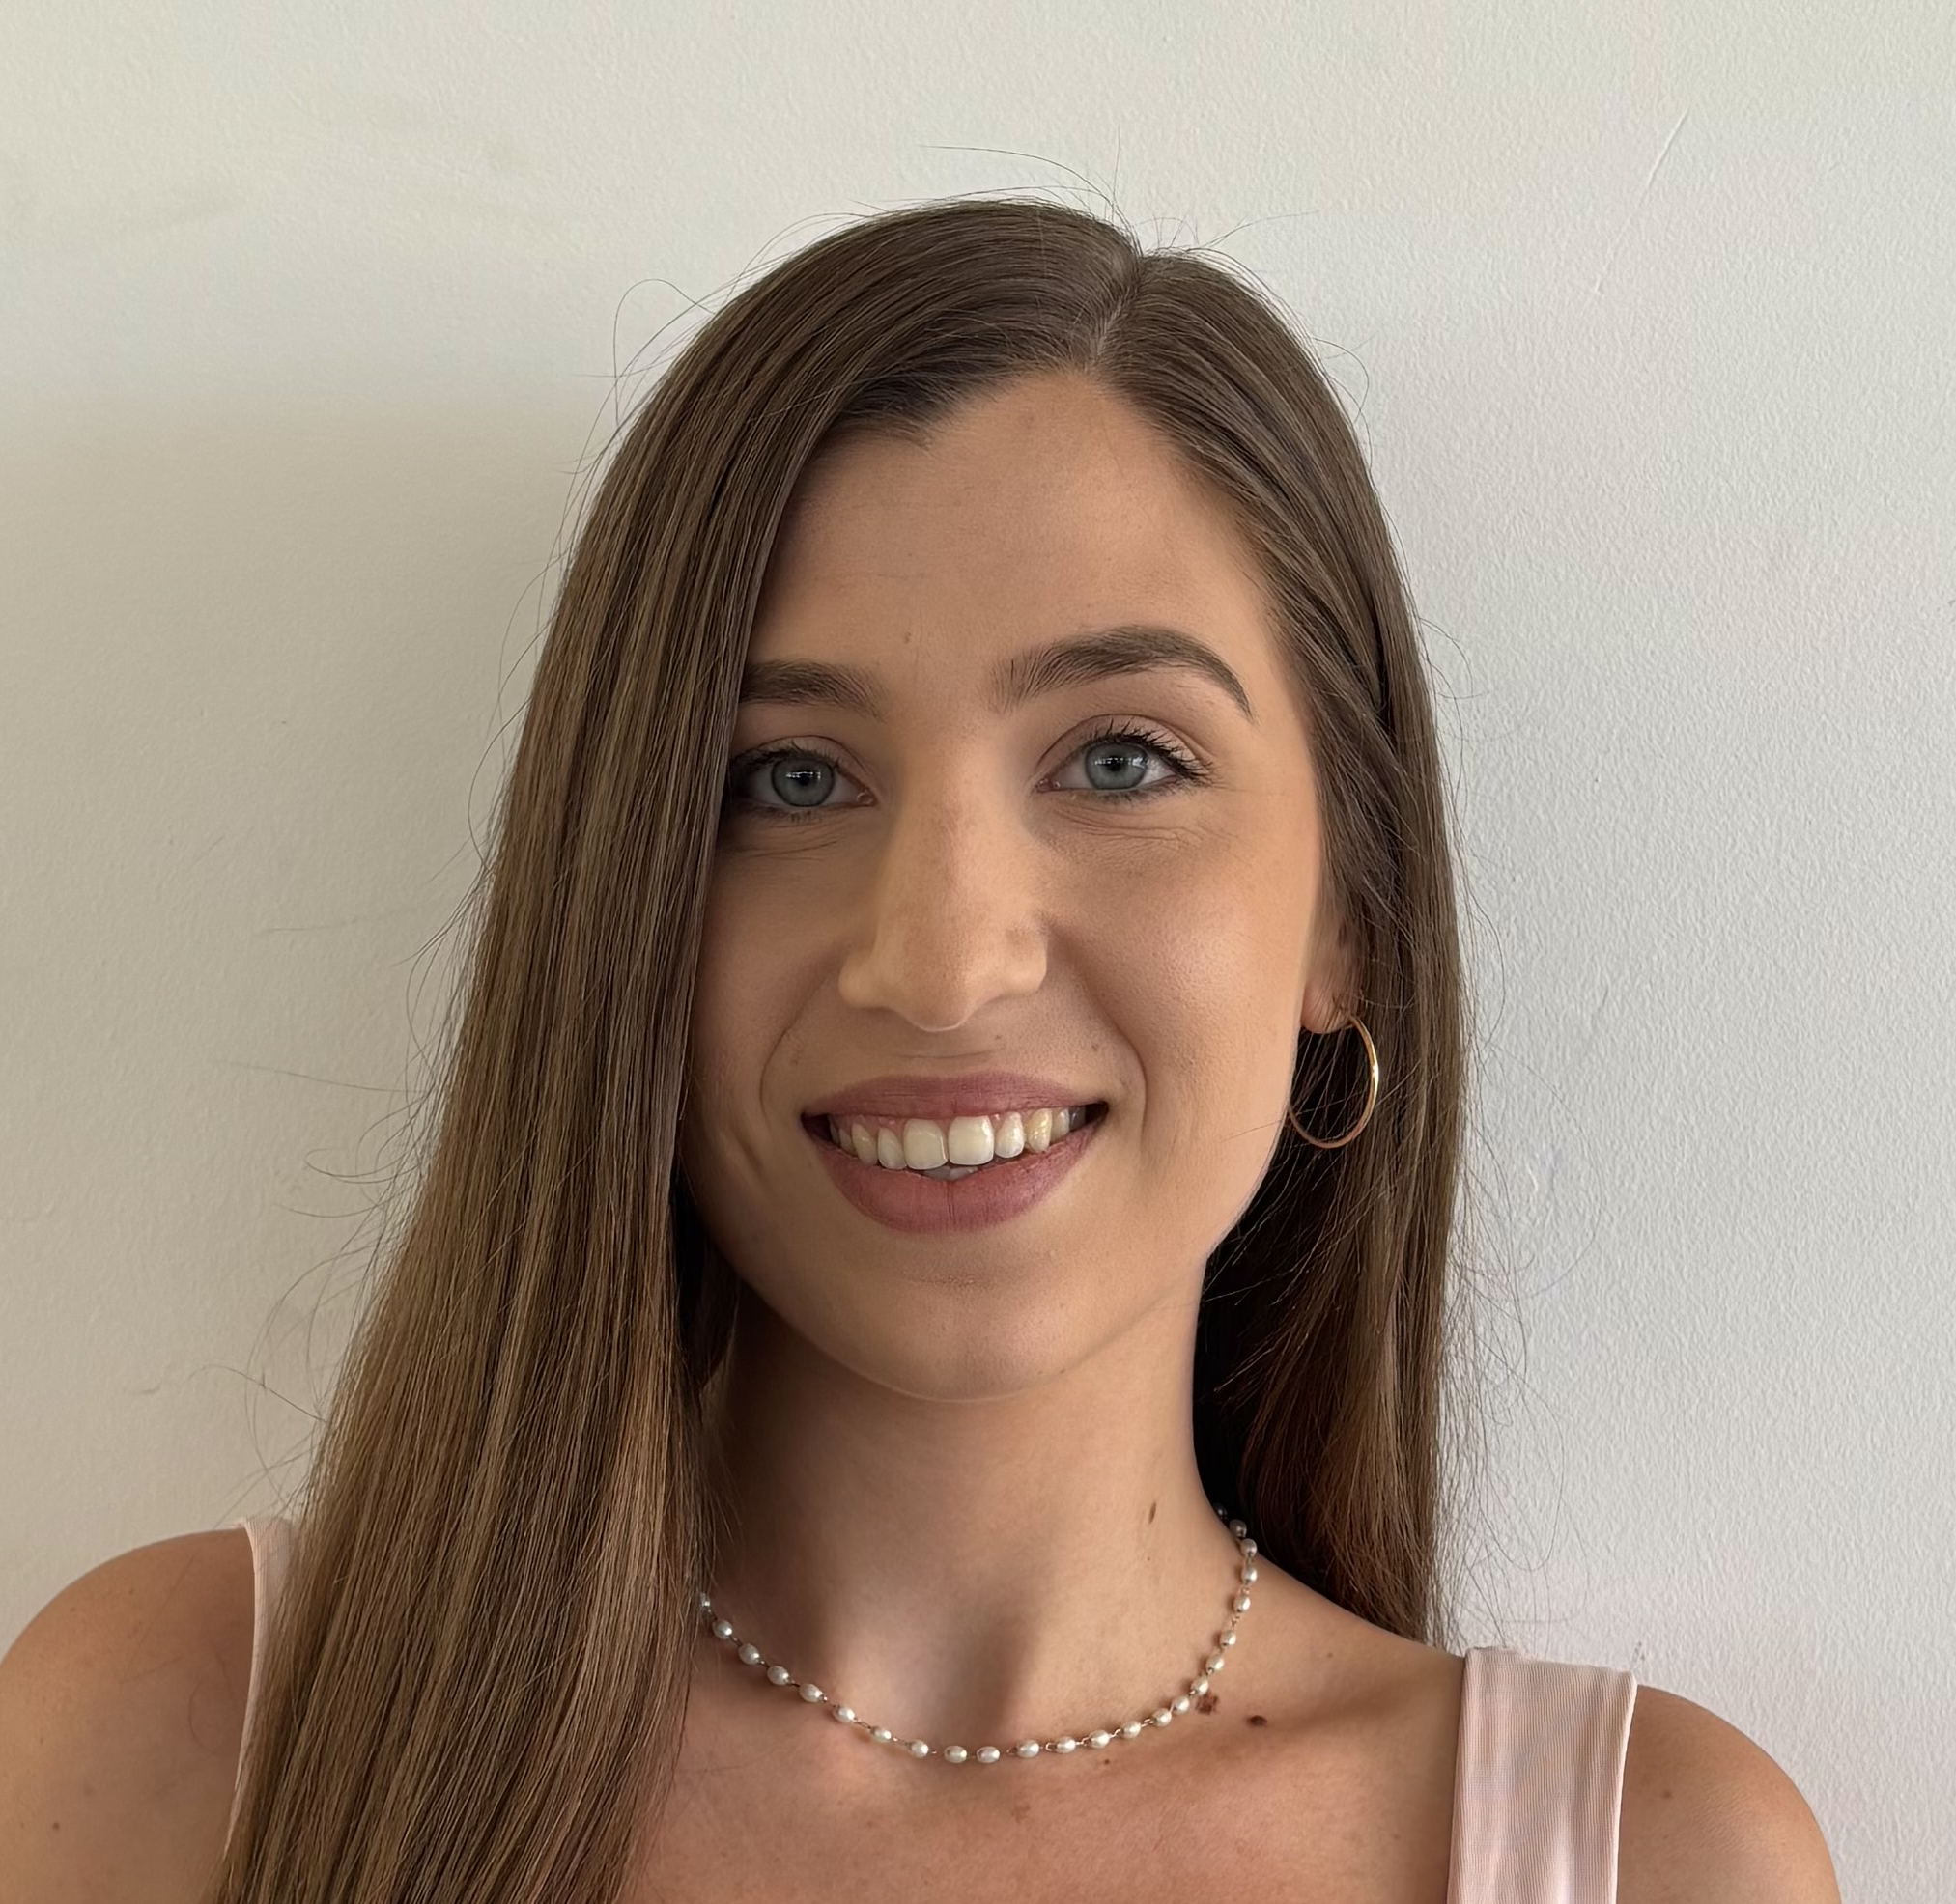
Faculty Welcome & Academic Year Kickoff
Welcome to our new faculty Members
Lorenzo Palladini
Marianna Constantinou
Diana Abbani
Christos
Hadjioannou
Assistant Professor,
Faculty of Business
PHOTO
Assistant Professor,
Faculty of Arts & Sciences
PHOTO
Assistant Professor & Chair of the Institute for the Liberal Arts, Faculty of Arts & Sciences
PHOTO
Special Scientist-Lecturer, Faculty of Arts & Sciences
Nandia Dedeletakis
Elizabeth Hoak-Doering
Aspasia Stephanou
Loubna Talbi
PHOTO
Special Scientist-Lecturer, Faculty of Arts & Sciences
PHOTO
Special Scientist-Lecturer, Faculty of Arts & Sciences
Instructor & Academic Affairs Assistant, Faculty of Arts & Sciences
Special Scientist-Lecturer, Faculty of Arts & Sciences
Christiana Kelepeshi
Alexandros Zachariades
Marielle Snel
Maria Mouskou
Special Scientist-Lecturer, Faculty of Arts & Sciences
PHOTO
Special Scientist-Lecturer, Faculty of Arts & Sciences
PHOTO
Special Scientist-Lecturer, Faculty of Arts & Sciences
Special Scientist-Lecturer, Faculty of Business
Giannis Savva
Panikkos Poutziouris
Revekka
Christodoulou
Anna Maria Kontou
PHOTO
Special Scientist-Lecturer, Faculty of Engineering
PHOTO
PHOTO
Special Scientist-Lecturer, Faculty of Business
Special Scientist-Lecturer, Faculty of Arts & Sciences
Special Scientist-Lecturer, Faculty of Arts & Sciences
A growing faculty community

Slide 8
Faculty Welcome & Academic Year Kickoff
Where we are going
Mission
Vision
AUB Mediterraneo is a twin campus of AUB, bringing over 160 years of educational excellence to Europe.
It prepares critical thinkers, global leaders, innovators, and responsible global citizens through a liberal arts model, cutting-edge research, experiential learning, and community engagement.
The campus fosters freedom of thought, tolerance, and respect for diversity, and serves as a hub for collaborative research and intercultural exchange.
A hub of knowledge exchange and creation that leads social, environmental, and technological advancement through state-of-the-art and pioneering educational offerings, cutting-edge research and knowledge creation, and impactful community service.​
pioneering educational offerings • cutting-edge research • knowledge creation• impactful community service

Slide 9
Faculty Welcome & Academic Year Kickoff
Our direction: vita 2032
VITA 2032 is the framework guiding the next stage of AUB Mediterraneo's development.
VALUE - Build a university grounded in shared values and connected to its community.
    Strengthen academic programs, partnerships, community engagement, scholarships, and the systems that support sustainable growth.
INTEGRATE - Connect what students learn across disciplines and with the world around them.
    Expand interdisciplinary, experiential, human-centered, and technology-enhanced learning across the university.
TRANSFORM - Make the student experience more connected, inclusive, and purposeful.
    Strengthen advising, student support, co-curricular opportunities, innovative teaching, and the campus environment.
ADVANCE - Build a stronger culture of research, innovation, and collaboration.
    Develop research support and opportunities, encourage cross-disciplinary work, and deepen partnerships that translate knowledge into impact.

Slide 10

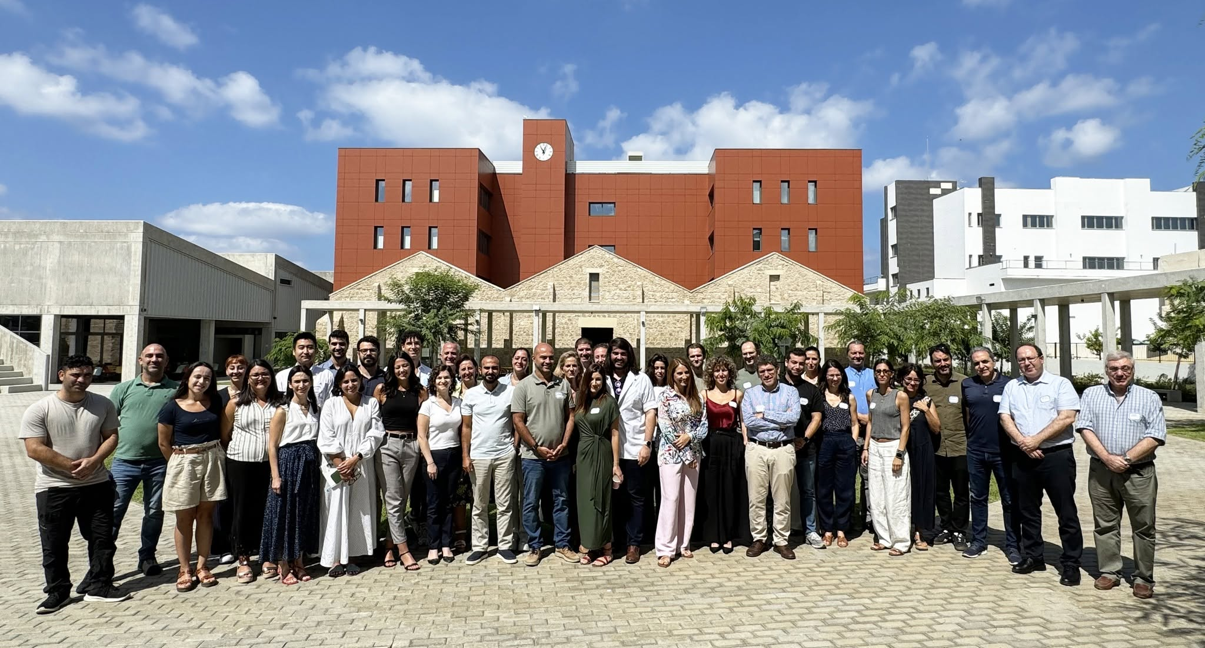

Building this campus together
At a small and growing university, every faculty member has an outsized impact.

Slide 11
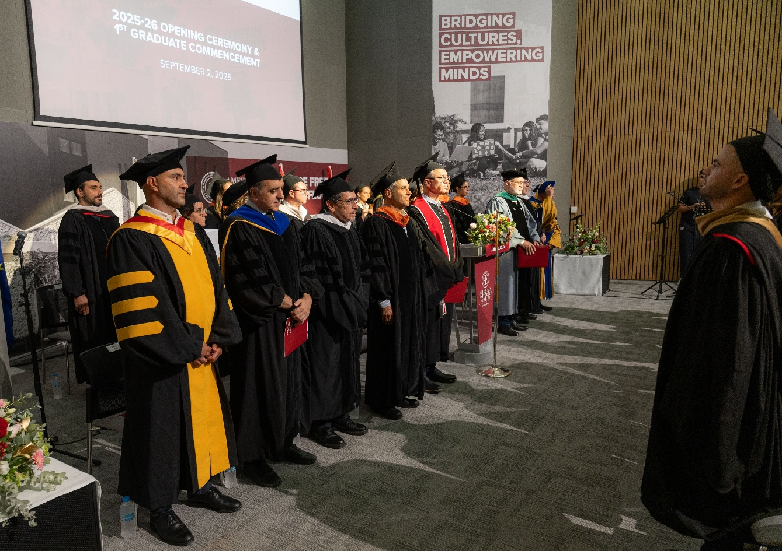
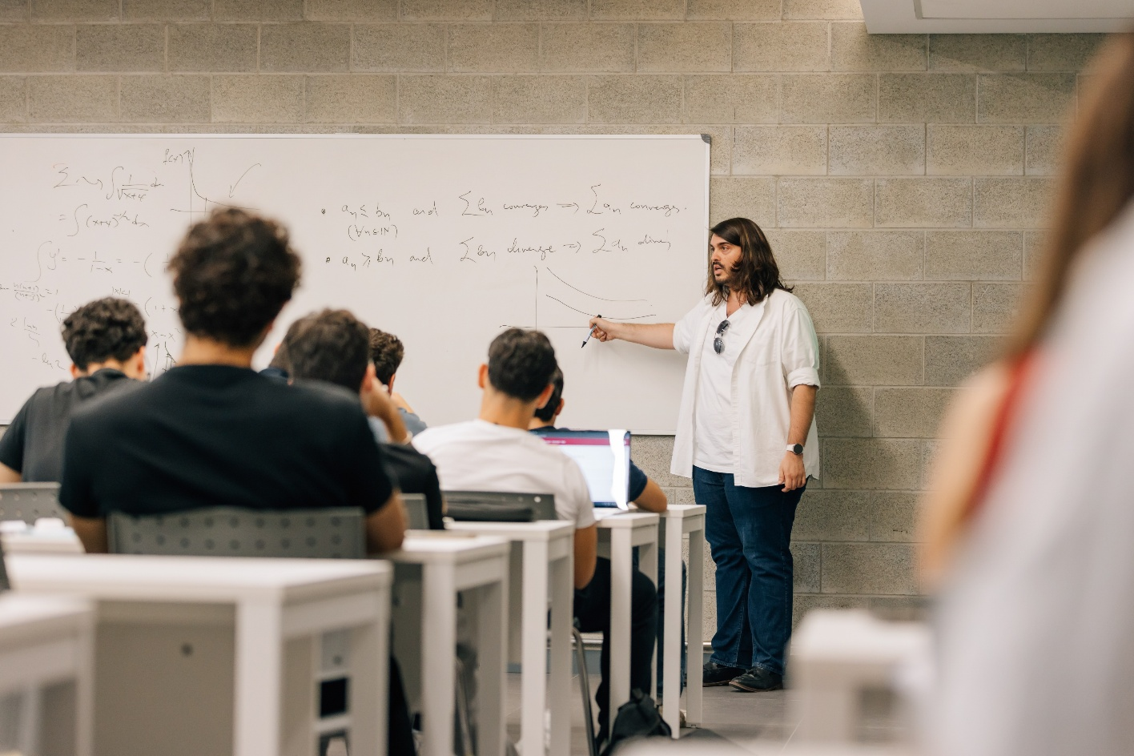
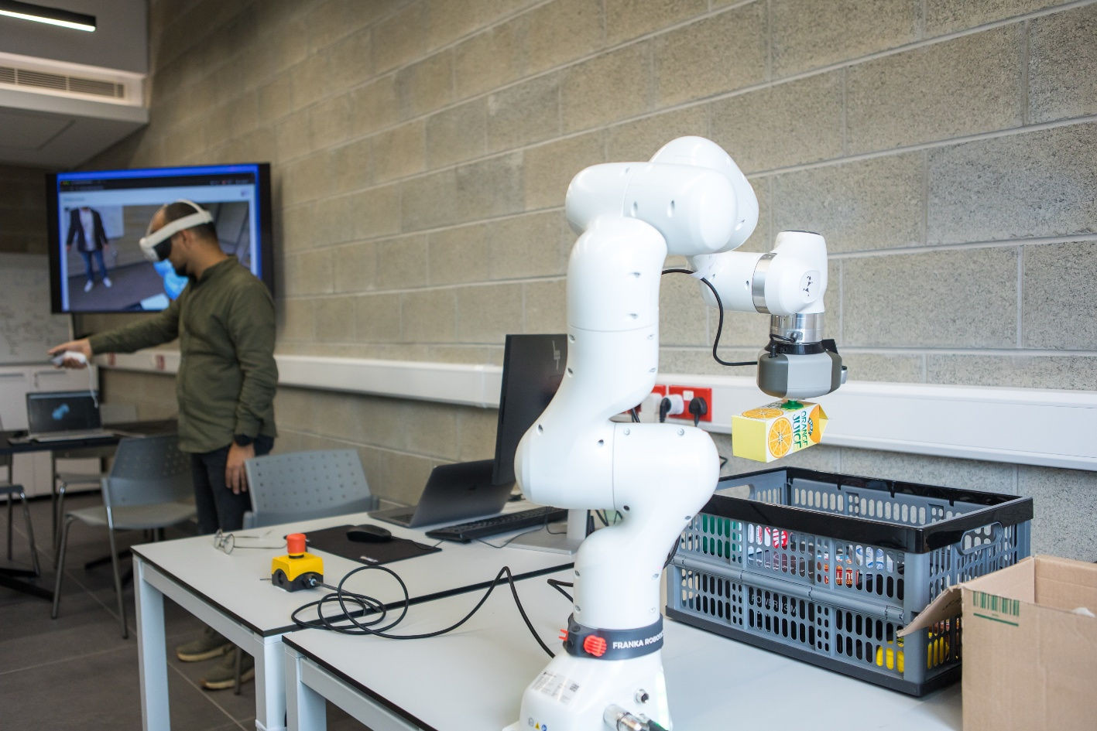
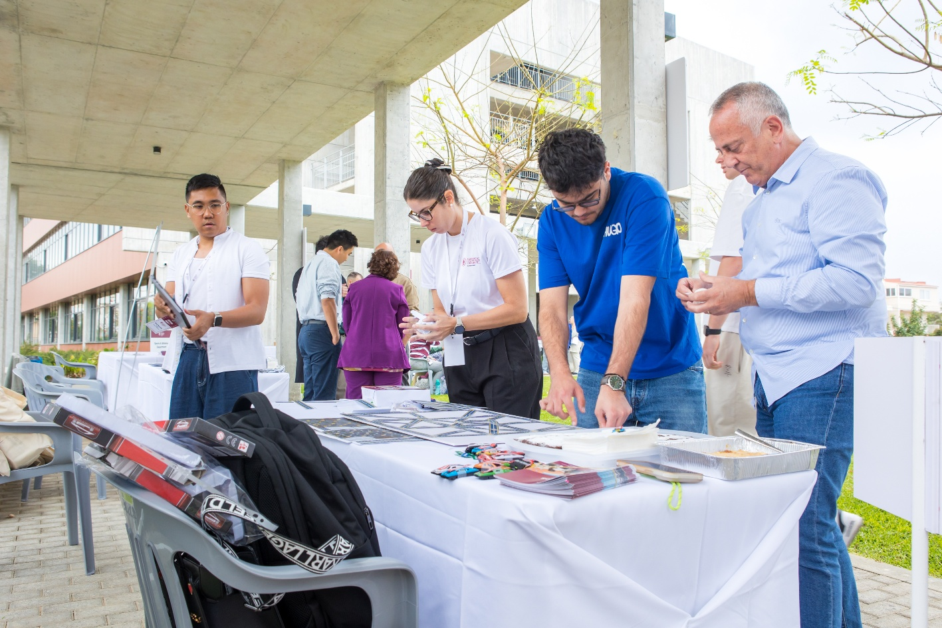
Faculty Welcome & Academic Year Kickoff
How we contribute
Teaching • Research • service

Slide 12
Faculty Welcome & Academic Year Kickoff
Teaching & student success
Teach
Advise & Mentor
Improve
Student-centered, liberal arts approach to education.
Challenges students to ask questions, make connections, and apply what they learn to real-world problems.
Rigorous, engaging, and inclusive lessons.
Clear expectations and provide meaningful, timely feedback.
Help students understand their academic (and career) path and make informed decisions.
Build relationships that extend beyond scheduled advising periods.
Use assessment, feedback and reflection to strengthen our courses and programs.
Attend faculty development workshops and trainings.
Participate and propose university-wide initiatives.
Student success is not a Registrar function, an advising-period activity, or an individual faculty member's responsibility. It is a shared responsibility across the academic community.

Slide 13
Faculty Welcome & Academic Year Kickoff
Research, scholarship & innovation
Connect & Collaborate
Create
Involve Students
Build connections with AUB Beirut and researchers internationally.
Develop interdisciplinary and external partnerships.
Pursue publications, grants, innovation and other forms of scholarly work.
Create opportunities for students to participate in research and scholarship.
Already happening: AUB connections | LINK initiative | External partnerships | Student research

Slide 14
Faculty Welcome & Academic Year Kickoff
Service & community engagement
University
Profession
Community
Participate in faculty governance, committees and institutional initiatives.
Contribute to program and university development.
Support the academic and broader campus community by mentoring student clubs, attending campus events, and participating in other activities that contribute to campus culture.
Engage with professional organizations and disciplinary communities.
Contribute through conferences, peer review, editorial work and other professional activities.
Build connections that strengthen the university's external profile.
Engage with the local Pafos/Cyprus community and wider society.
Contribute expertise to public, civic, cultural or other external initiatives.
Develop partnerships and activities that extend the university's impact beyond campus.
As we grow, there will be more opportunities (and more need) for faculty leadership.

Slide 15
Faculty Welcome & Academic Year Kickoff
Faculty senate
Launching this fall • Faculty elections to follow
Faculty Elections
Standing Committees
Faculty Voice
Faculty representation
Shared academic work
Shared academic decision-making
As AUB Mediterraneo grows, faculty participation in academic governance will grow with it.

Slide 16
Faculty Welcome & Academic Year Kickoff
Important Expectations & Reminders
Ensuring a safe and respectful workplace
TITLE IX & NON-DISCRIMINATION - Know the policy. Know how to respond. Know where to report.
    Complete the mandatory Title IX/anti-discrimination training.
    Maintain a learning and working environment free from discrimination and harassment.
    Report concerns to the Title IX Coordinator or any Title IX Deputy (refer to Title IX page on the website)
    Know the University's reporting and support procedures
    Title IX Coordinator: Mitra Tauk, titleix@aubmed.ac.cy
HEALTH & SAFETY - Everyone has a role in keeping our campus safe.
    Complete required Health & Safety training in Moodle
    Know your building's emergency procedures, exits and equipment
    Report injuries, accidents, hazards and near misses
    Follow safety requirements for labs, equipment and specialized activities
ACADEMIC RESPONSIBILITIES - Consistency matters to our students and to one another..
    Follow University policies and approved course requirements
    Apply attendance, grading and academic integrity policies consistently
    Follow procedures for exams, accommodations and course evaluations
    Maintain accurate records and meet academic deadlines
    Raise questions or concerns early with your Dean or Academic Affairs
    Review Faculty Teaching Manual

Slide 17
Faculty Welcome & Academic Year Kickoff
Faculty Resources: Who can Help?
Student concerns | Deans, Student Affairs Committee, Counselling Center (counselling@aubmed.ac.cy), Accessible Education Office (aeo@aubmed.ac.cy)
Registration, grades, scheduling | Office of the Registrar (registrar@aubmed.ac.cy) Rami Kassem (Registrar)
Academic & accreditation | Elizabeth Sweetman (Academic Affairs & Accreditation Manager)
Library | Christos Kotsias (local librarian) Fatme Charafeddine (fc01@aub.edu.lb) – AUB Resource
Communications | Communications team (communication@aubmed.ac.cy) Ghina Ramadan (Marketing & Communications Officer)
Research and grants | Research Committee (research@aubmed.ac.cy) Monica Tsartsali (Grants Officer)
Employment & HR matters | Rector, Deans, hr@aubmed.ac.cy
Facilities | Facilities Service Desk Michalis Hadjiarapis (Facilities Manager)
IT | IT Service Desk (it.servicedesk@aubmed.ac.cy) Olaf Machul (IT Officer)
Student Affairs | Office of Student Affairs, osa@aubmed.ac.cy Simone Tourkomenis-Kollias (st00@aubmed.ac.cy)

Slide 18
Thank you

