Slide 1







New Faculty Orientation
Fall 2026–2027

Slide 2
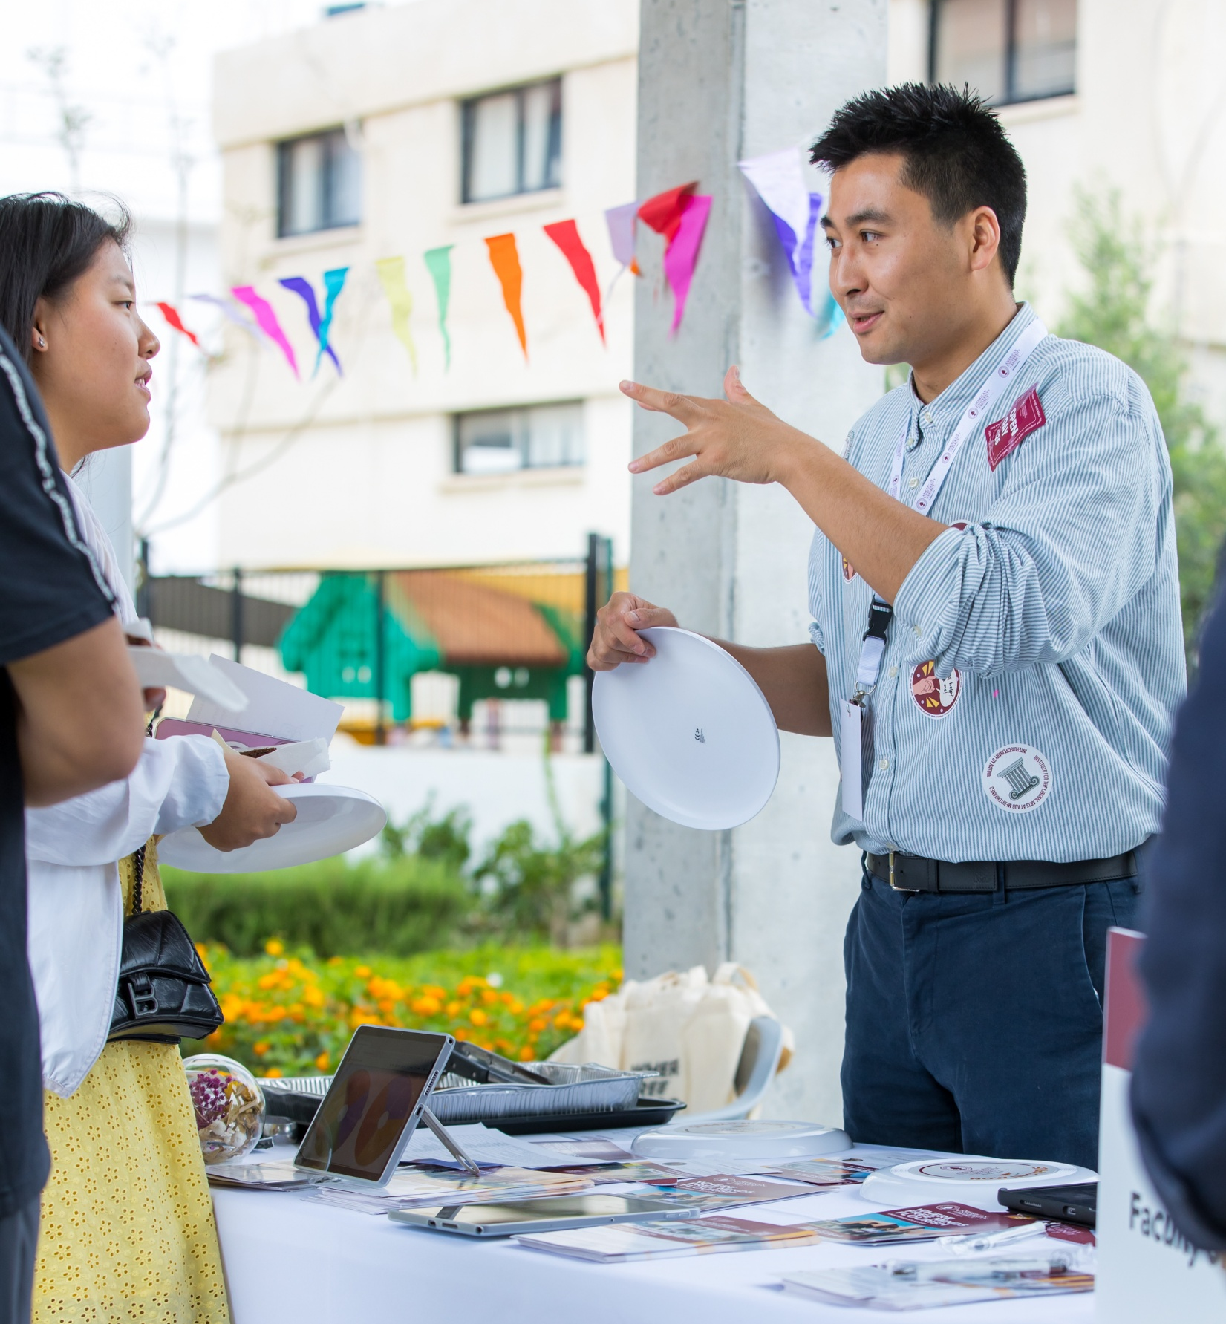
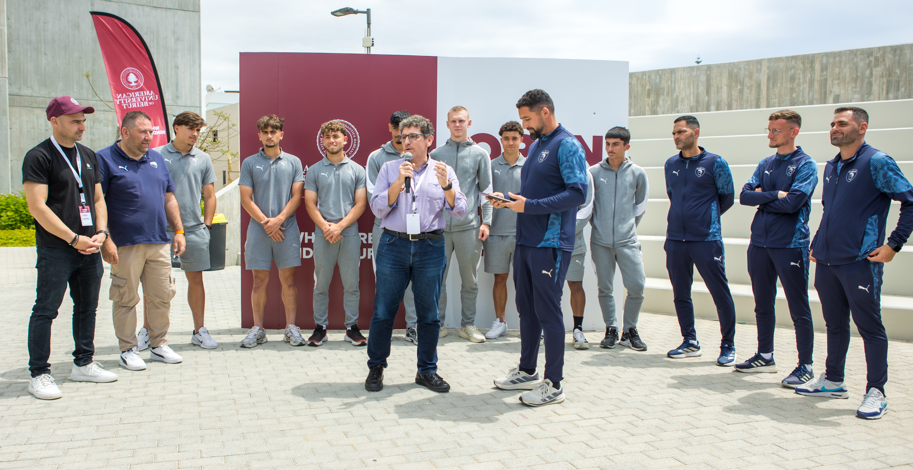
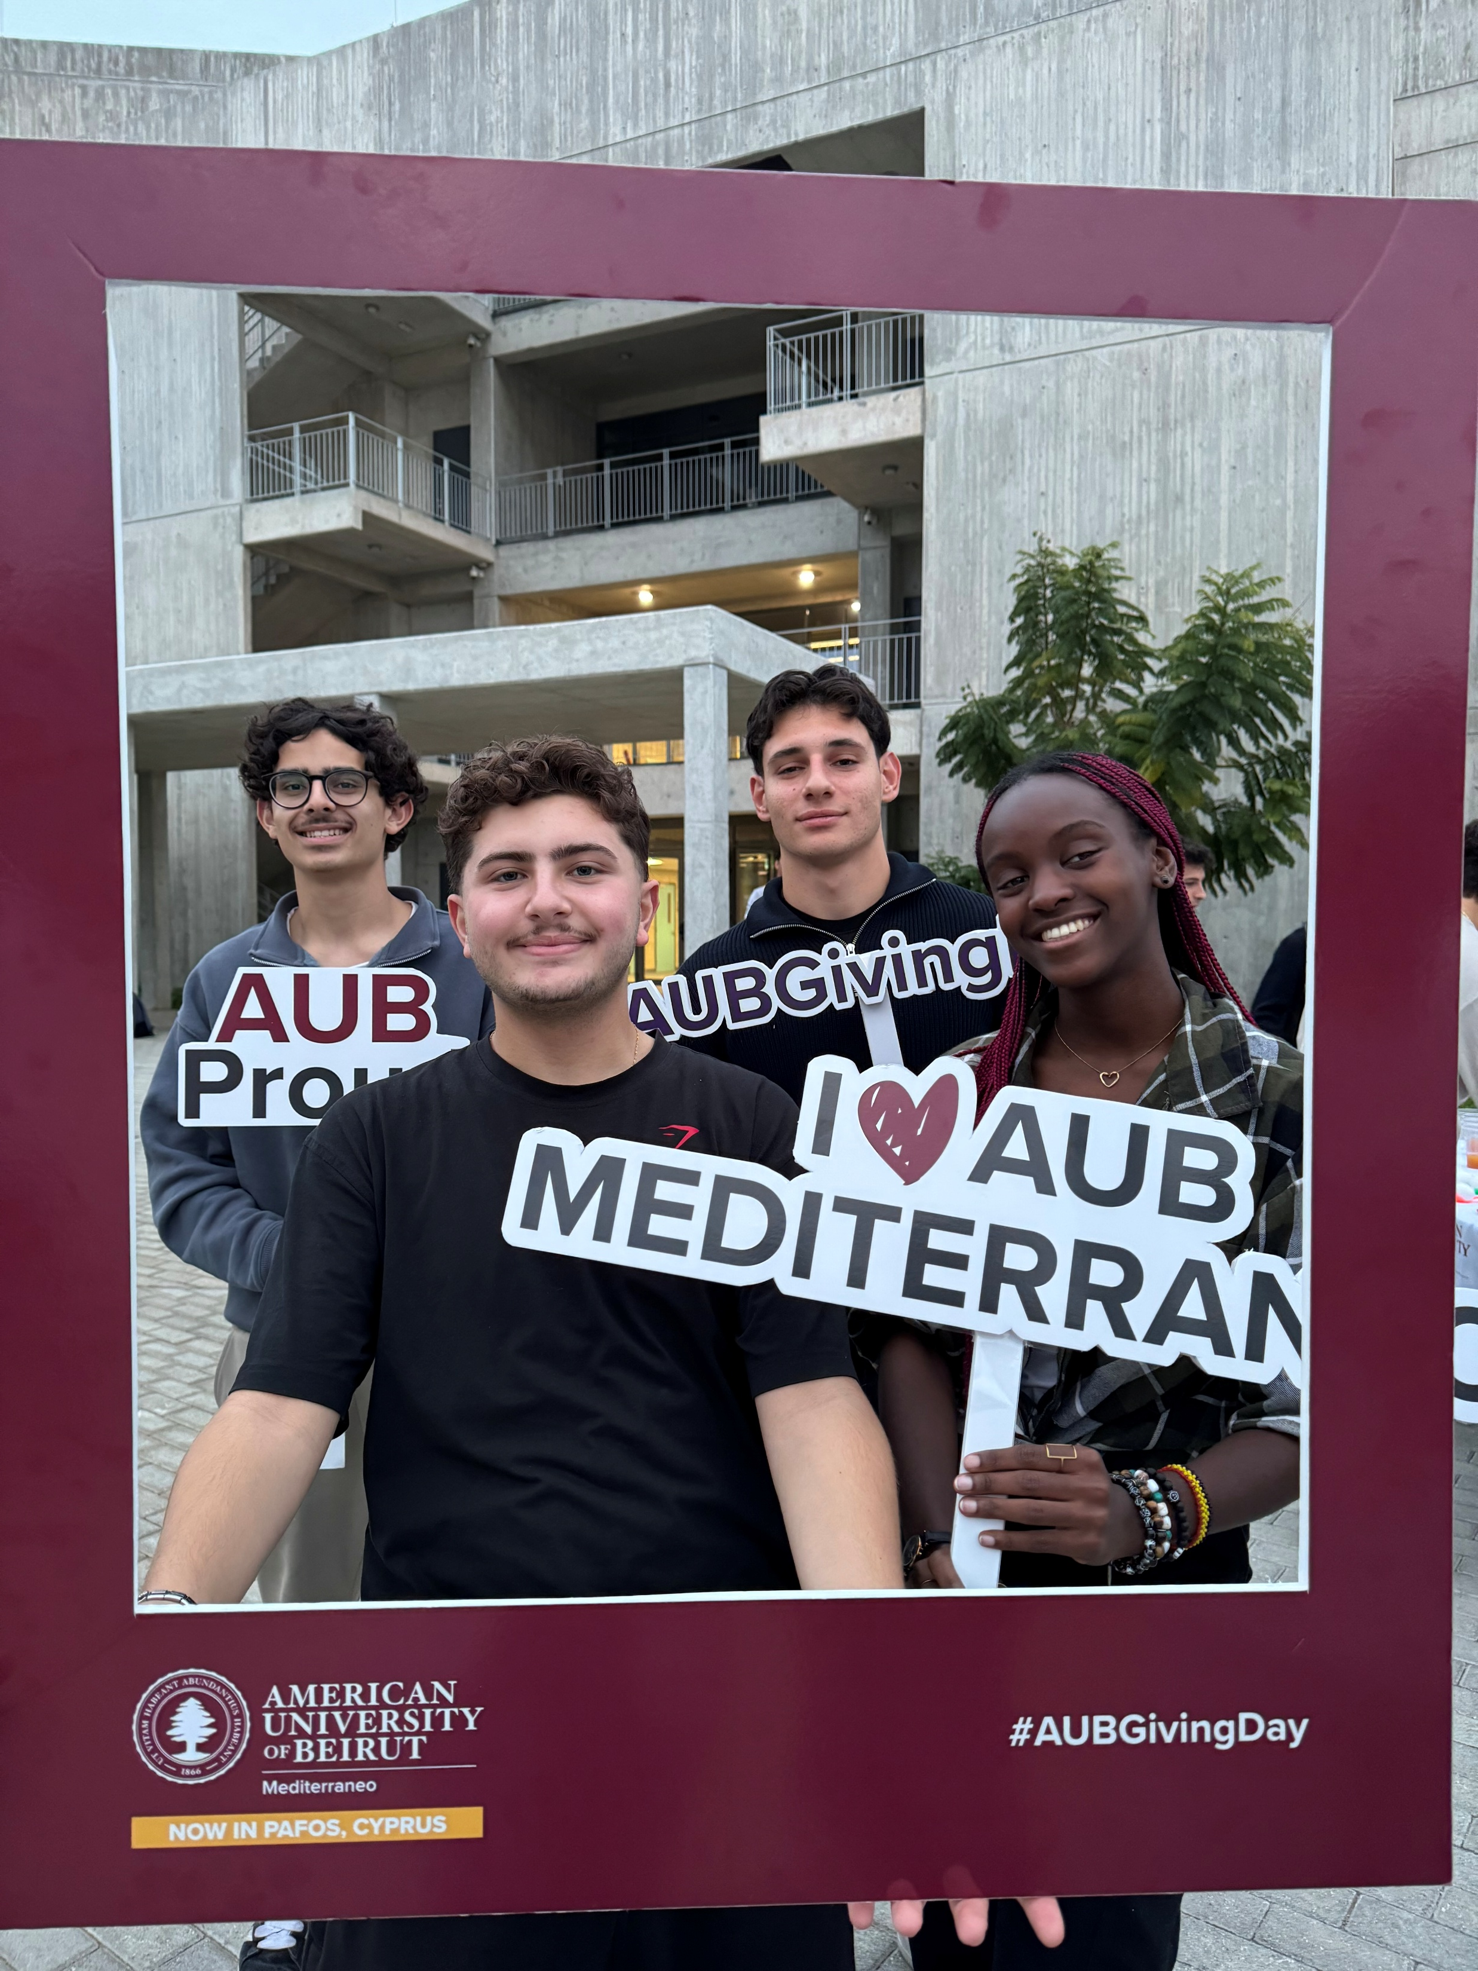
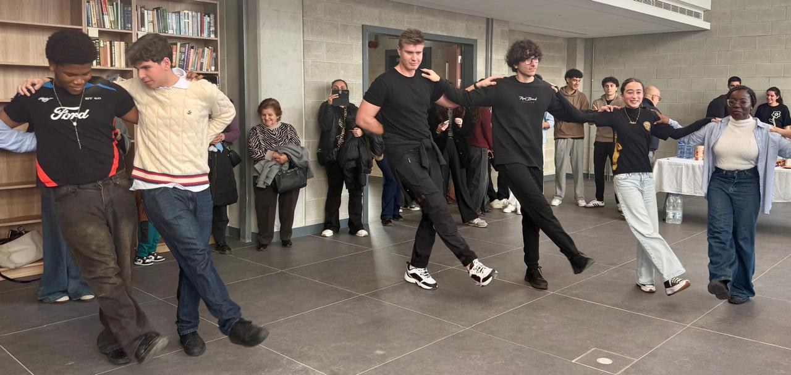
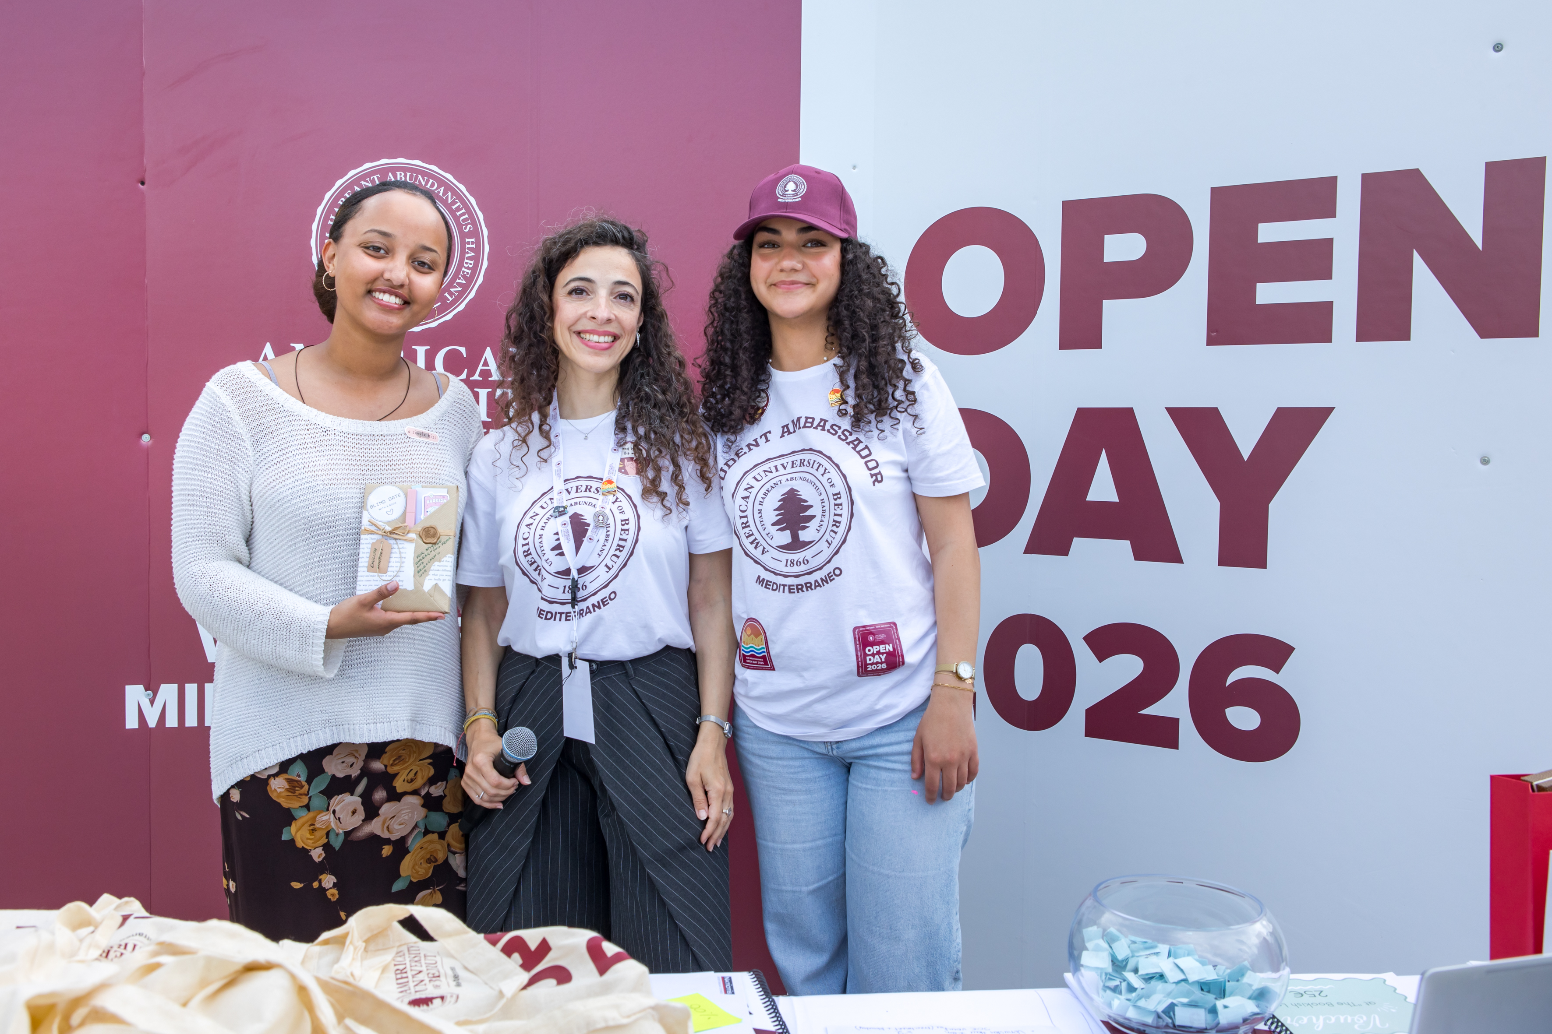
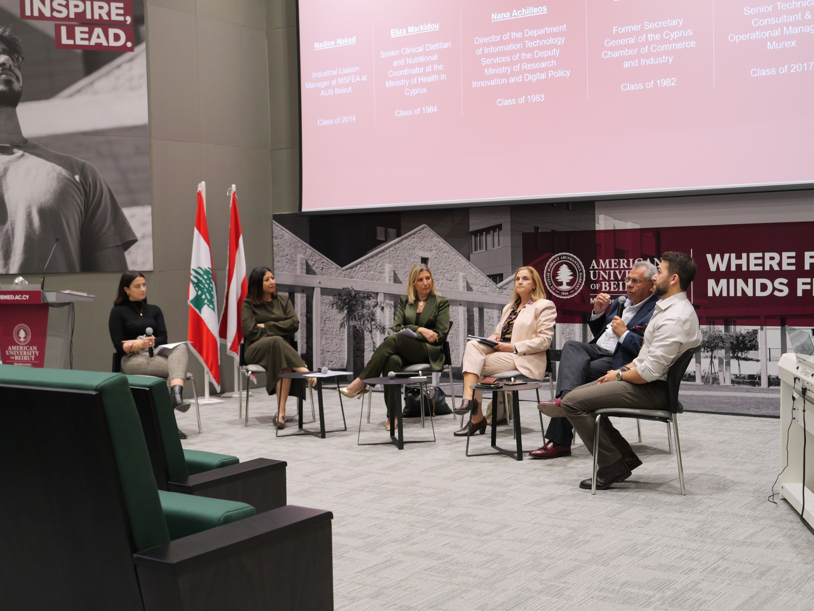
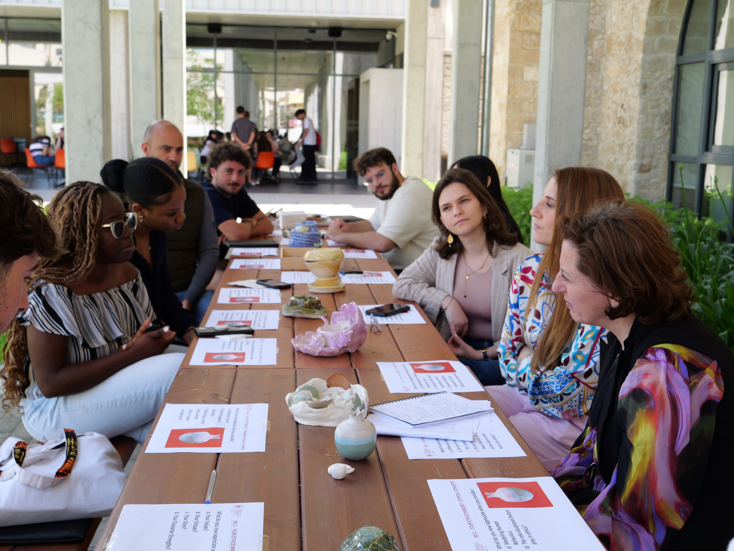
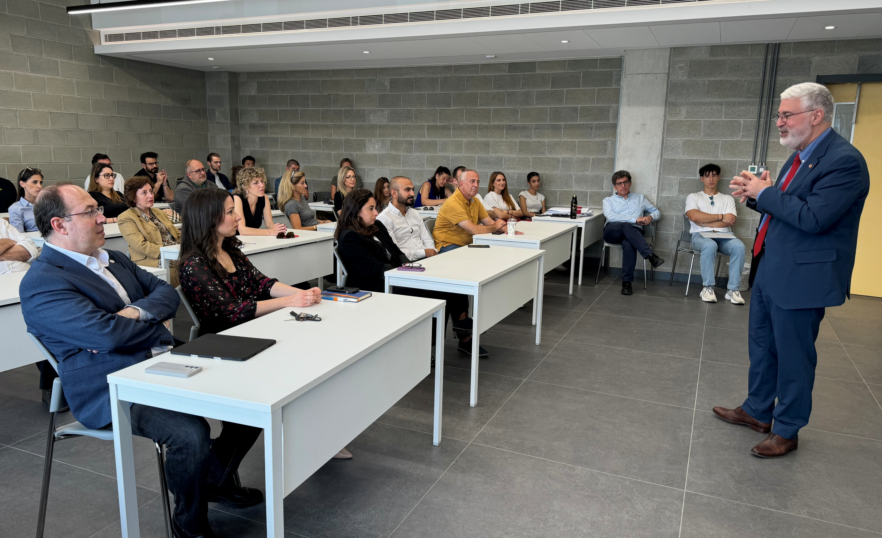
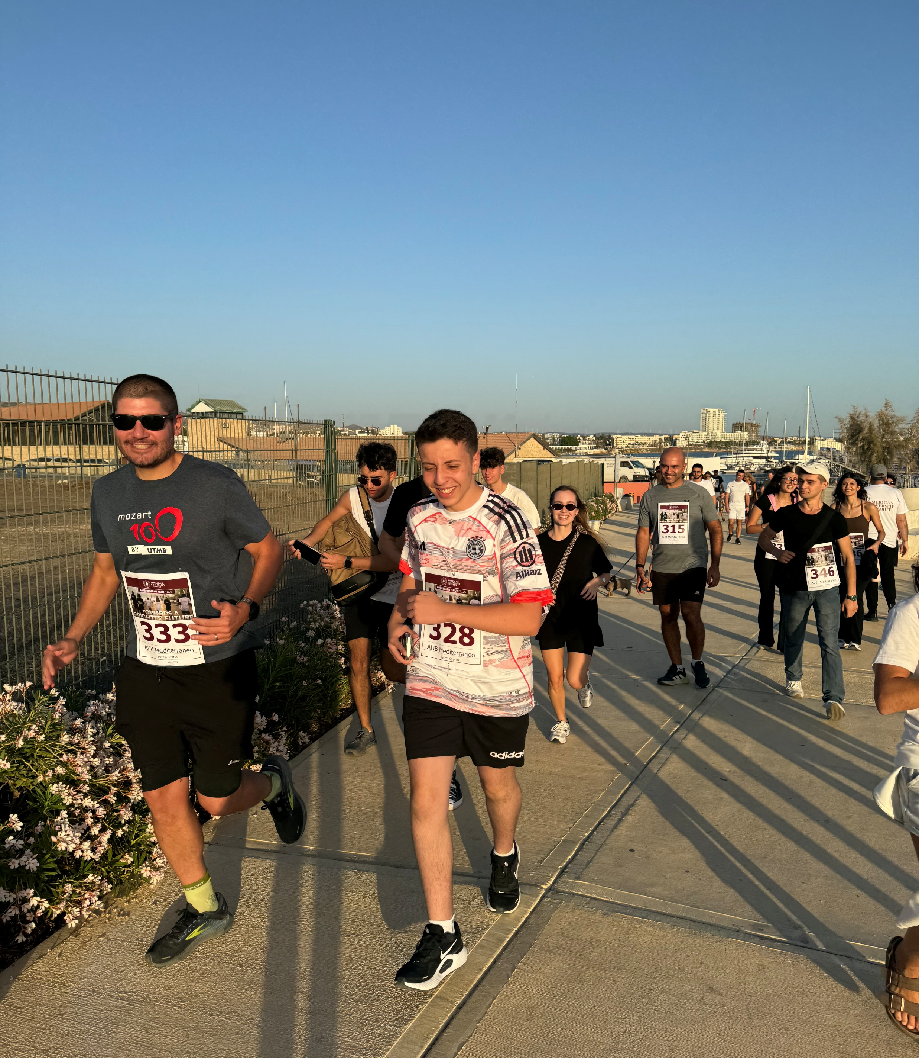
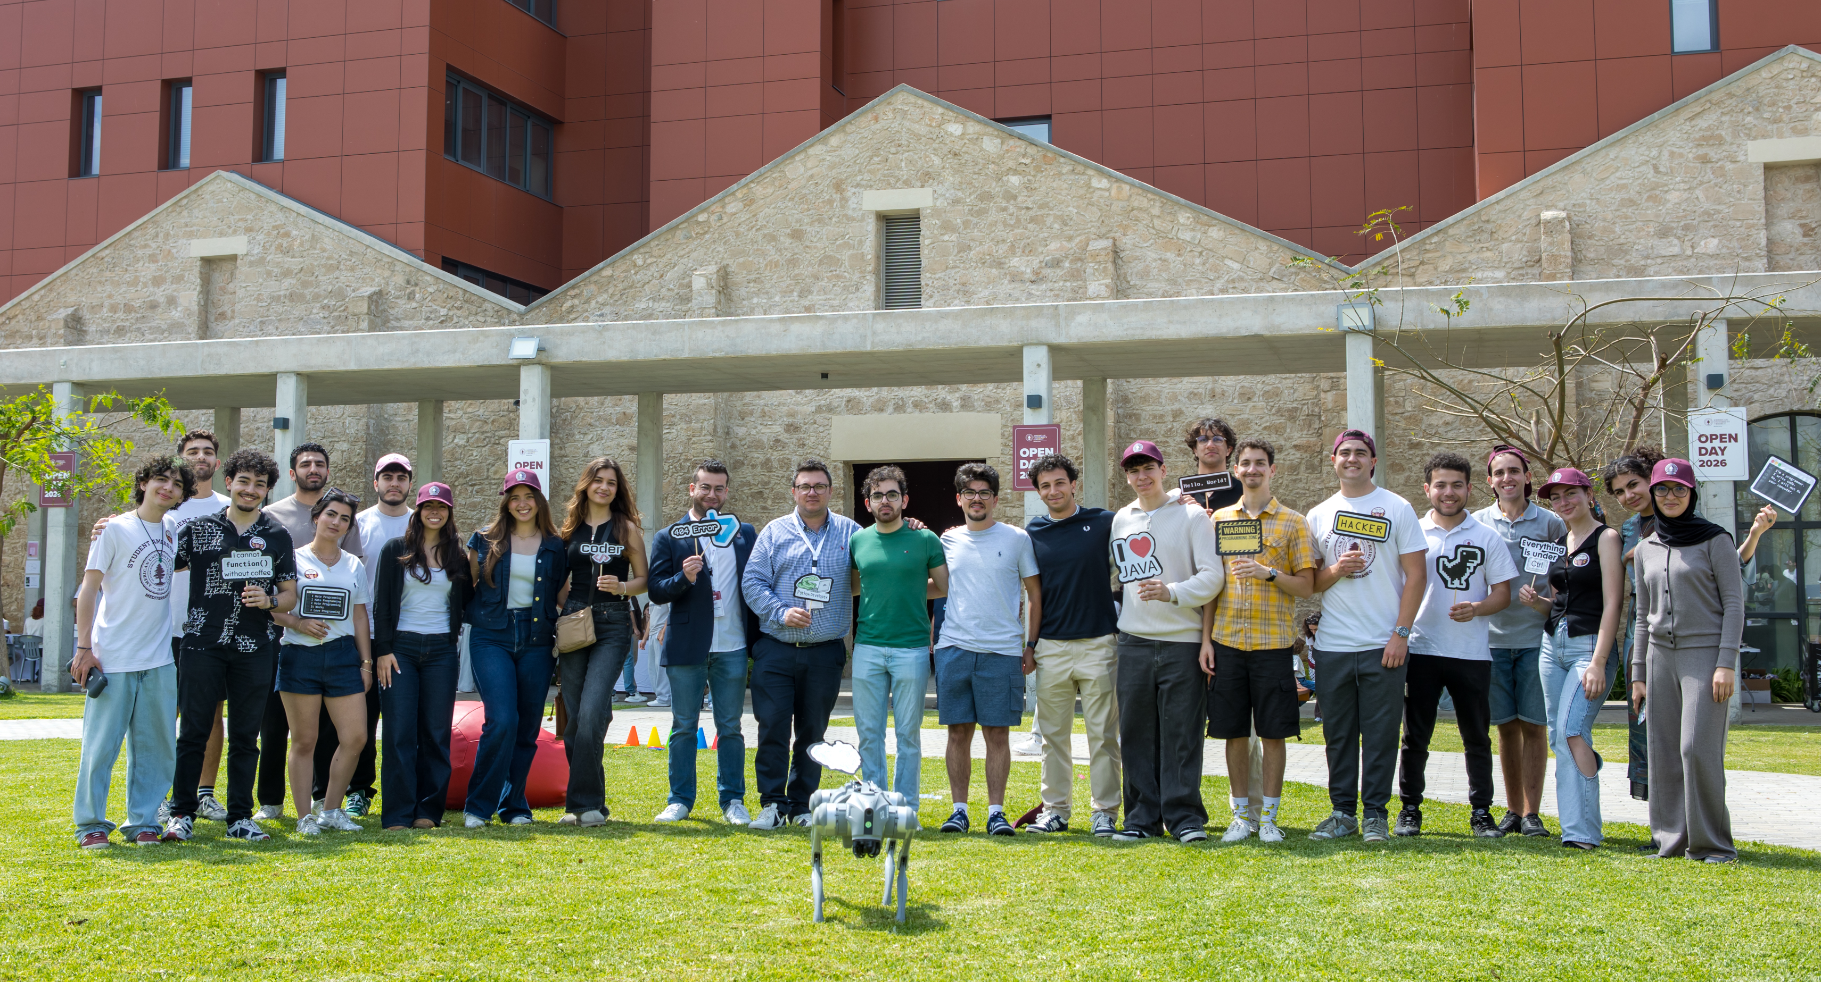
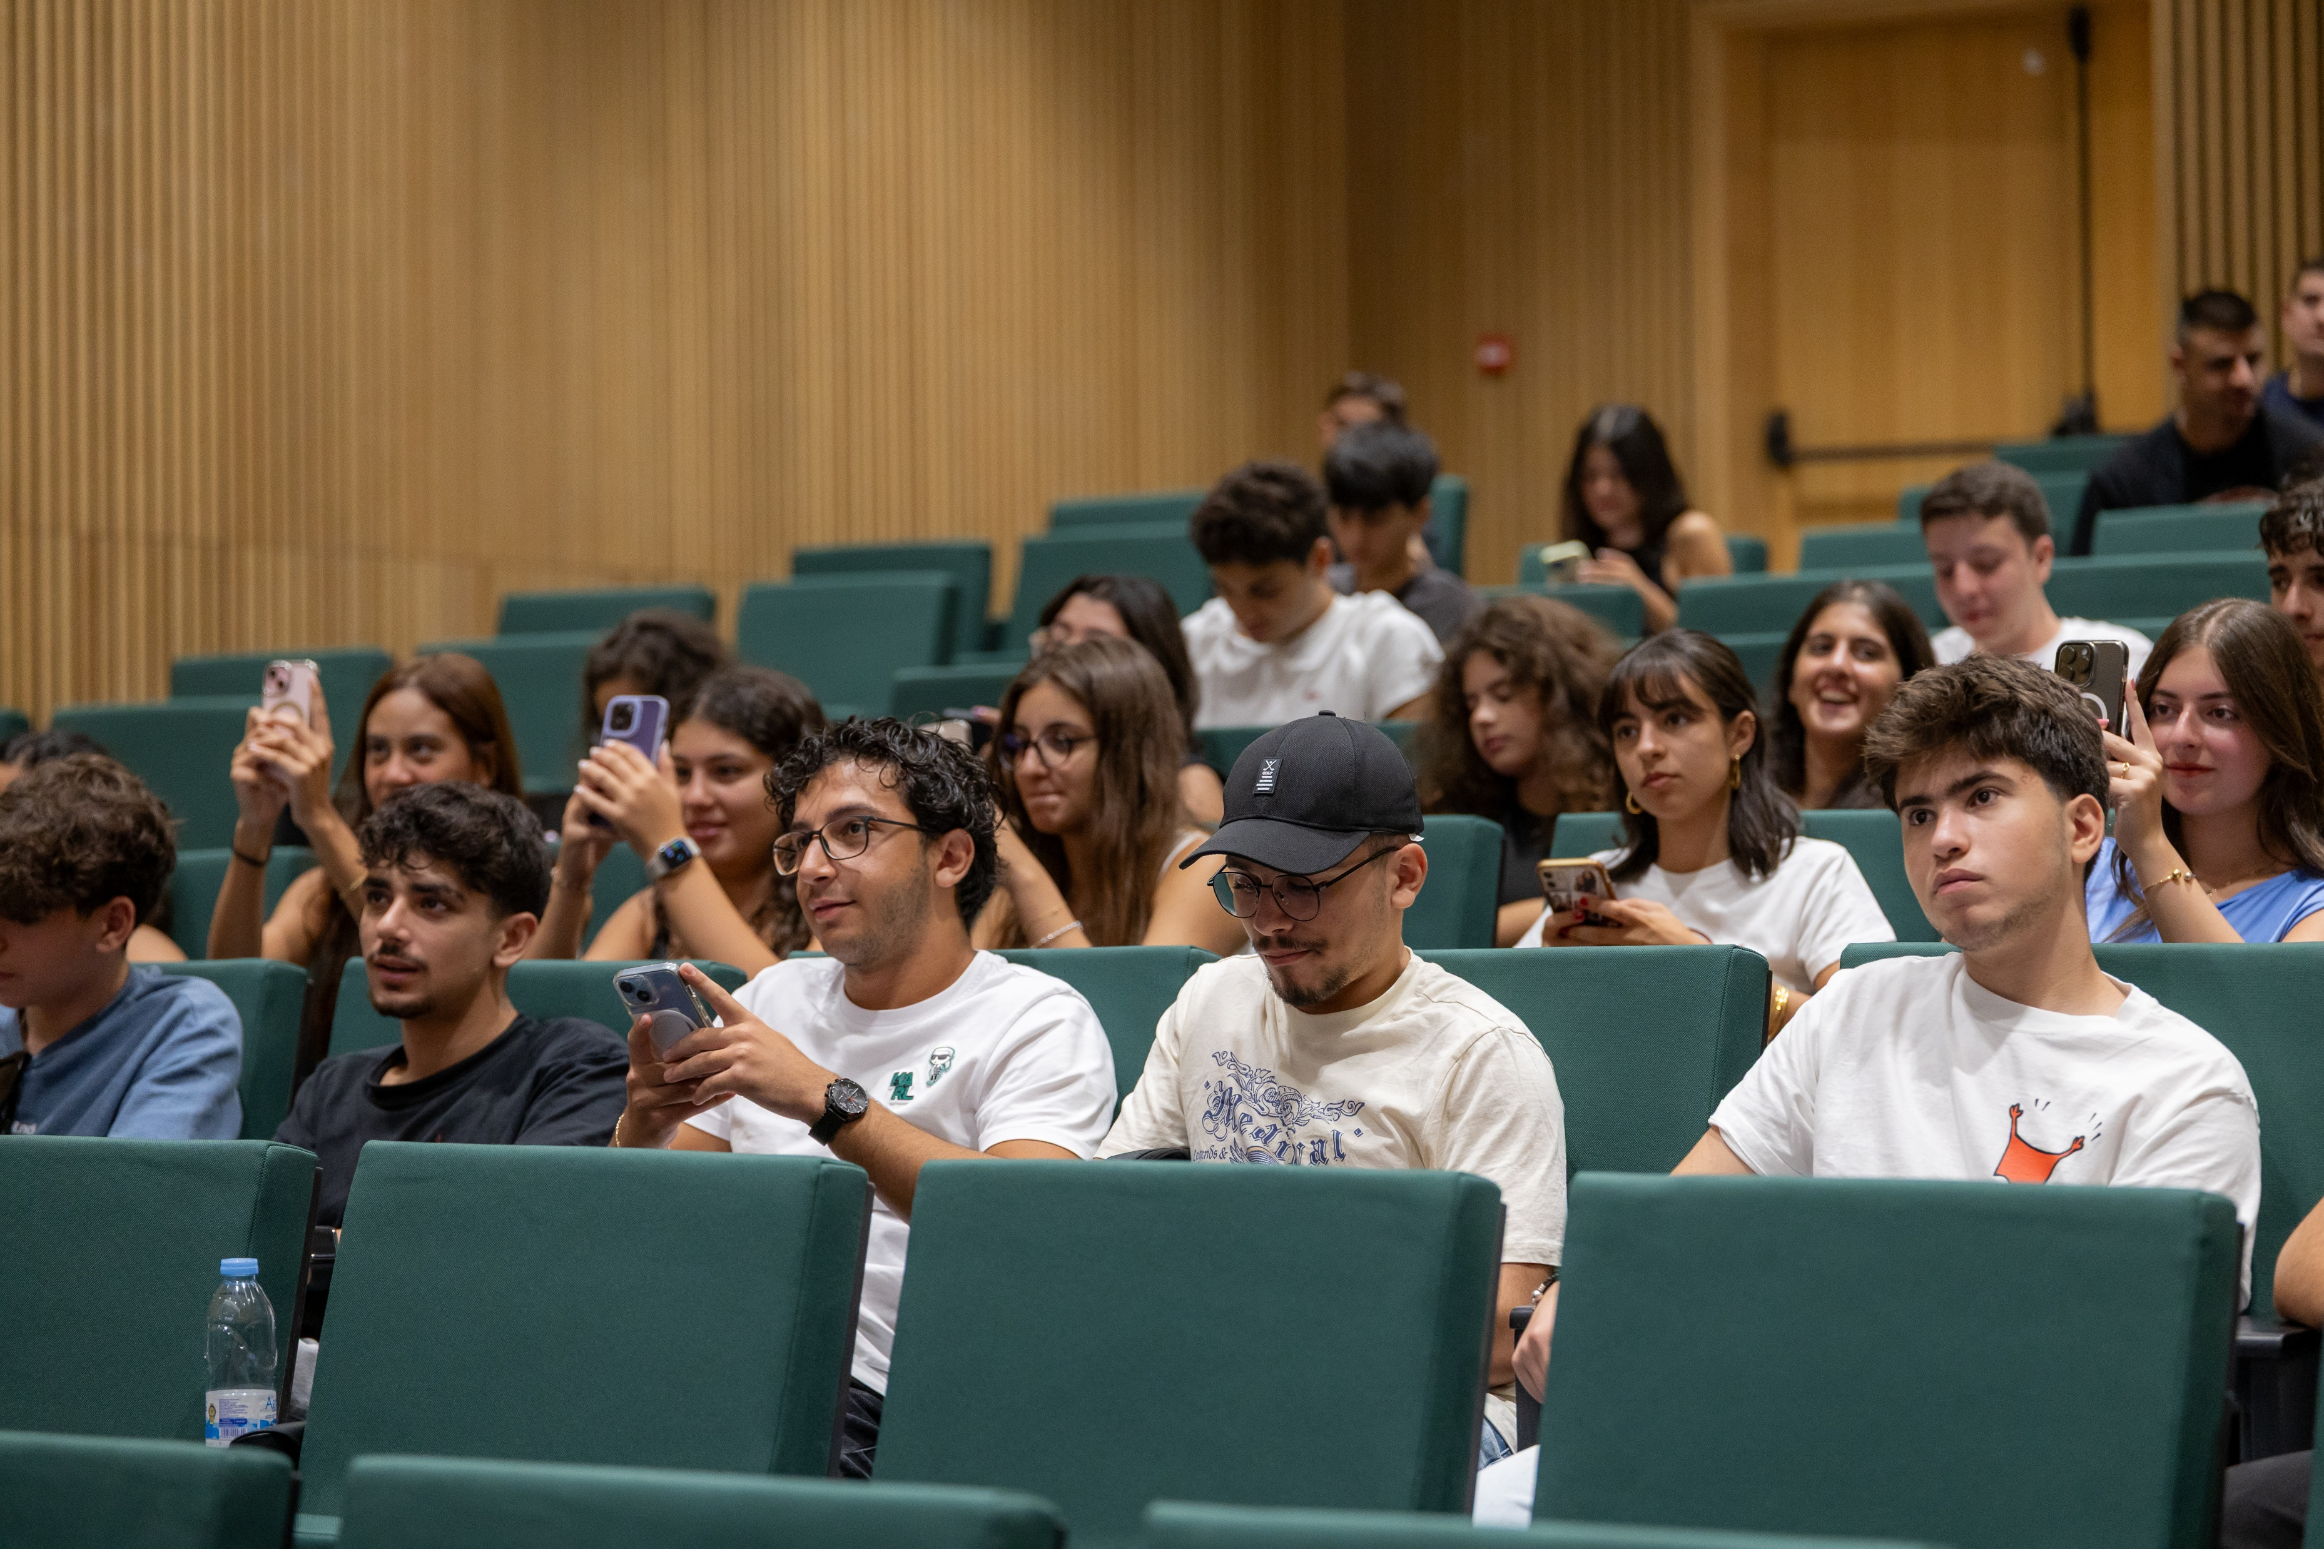
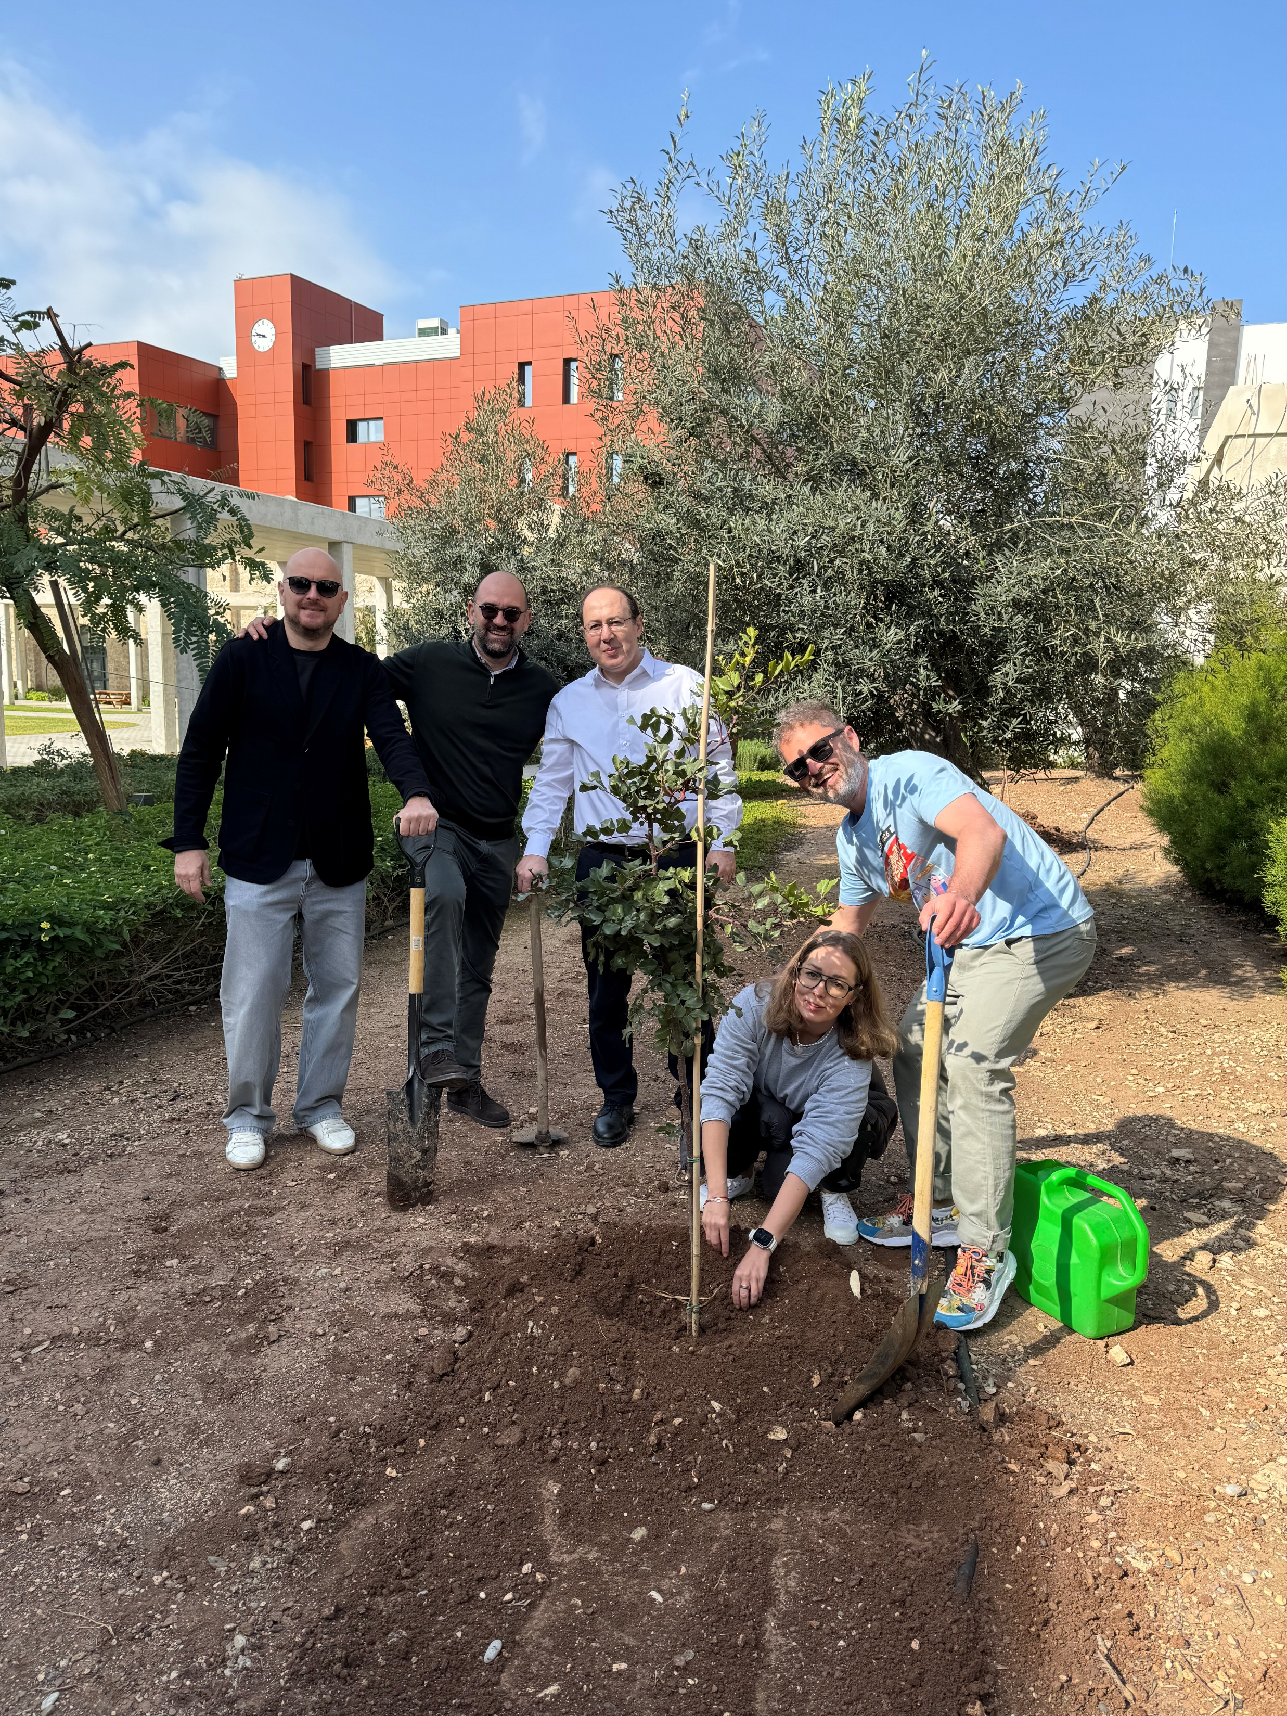
Welcome to AUB Mediterraneo
A twin campus of the American University of Beirut (AUB) in Beirut, Lebanon.

Slide 3











Agenda
Welcome & Introductions
Meet your new colleagues
Who Supports You
Staff presentations & key contacts
Teaching at AUB Mediterraneo
Liberal arts pedagogy, course design & assessment
Academic Expectations
Grading, attendance, office hours, evaluations & course portfolios
Supporting Our Students
Academic integrity, student support & referrals
What Would You Do?
Faculty Manual scenario challenges
Teaching Swap
Share your favorite teaching strategies

Slide 4
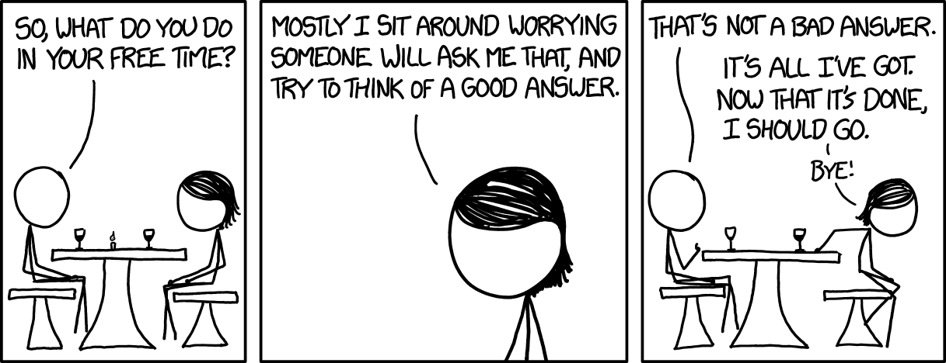
Please briefly introduce yourself:
Name & academic field
What you will teach at AUB Mediterraneo
Your academic/professional background
One superpower you bring to the classroom
Questions?
Meet Your New Colleagues

Slide 5

Staff Presentations

Slide 6
Placeholder for staff slides

Slide 7
Teaching at
AUB Mediterraneo

Slide 8

Faculty Orientation Fall 2026-27
Teaching at a Liberal Arts Institution
Our courses should help students develop more than just their disciplinary knowledge.
Teach students how to think, not simply what to know.
Build critical thinking, inquiry, communication and ethical reasoning into disciplinary learning.
Move beyond passive content delivery: use discussion, problem-solving, student presentations, flipped classroom, cases, projects, collaboration and other active learning where appropriate (refer to Faculty Teaching Manual II: Pedagogical Guide).
Make connections across disciplines and to real-world questions.
Create an environment where students can question, disagree respectfully and develop independent judgment.
Liberal arts pedagogy does not mean making an engineering course into a humanities course. It means teaching the discipline in a way that develops independent thinking, communication, ethical judgment and the ability to apply knowledge.

Slide 9
Faculty Orientation Fall 2026-27
Course Design: Start with Learning Outcomes
Learning outcomes → Assessment → Learning activities
Course design should begin with learning outcomes:
Assess what you say students should be able to do.
Use class activities to give students opportunities to practice those skills before assessment.
Use a mix of formative and summative assessment.
Avoid assessments that measure only recall when the learning outcome requires analysis, application or evaluation.
Build in mechanisms into assessment that minimize opportunities for academic dishonesty. This includes mindfully incorporating AI and other tools (refer to university’s AI Guidelines).

Slide 10
Faculty Orientation Fall 2026-27
Assessment & Grading
ASSESS WELL
Plan early: at least 40% of the final grade assessed and returned before the Week 12 withdrawal deadline.
Use clear rubrics for major assessments.
Give timely, specific, actionable feedback.
Assess what the learning outcomes require.
GRADE REVIEWS & FINAL GRADES
Syllabus must include standard grade-review statement; for grading errors, students use the formal Grade Review Request process (not email negotiation).
Submit final grades, obtain Dean validation and post through the Faculty Portal within 72 hours of the final exam (do not share grades verbally or via email because a student may have a hold on their account).
GRADE CONSISTENTLY
Grades reflect demonstrated achievement, not effort or completion.
Apply published criteria consistently. Grades are not negotiated.
A/A+ = exceptional mastery.
Review your average and grade distribution for rigor and meaningful differentiation.
KEY GRADING PRINCIPLES:
Grades should be explainable.
Students should understand what they were assessed on, the criteria used, and why they received the grade.

Slide 11
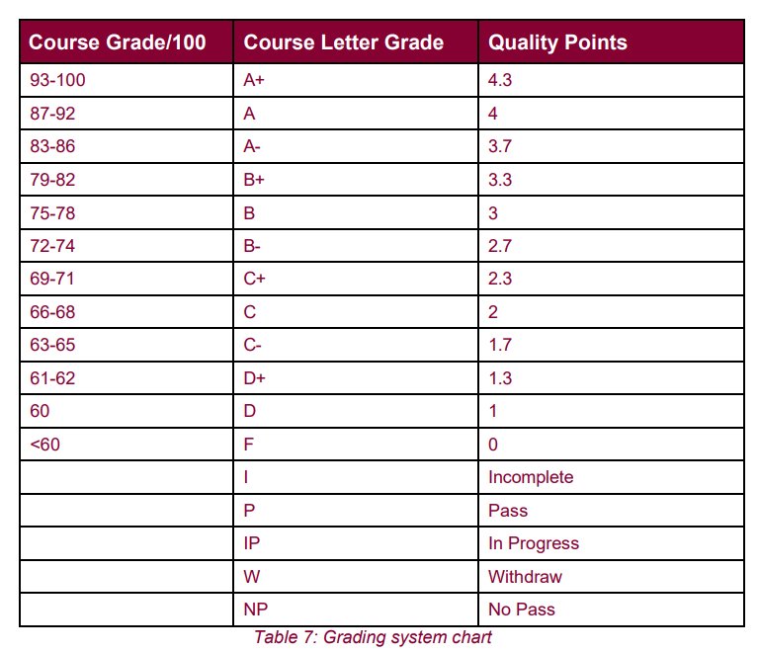
Faculty Orientation Fall 2026-27
Understanding Our Grading System
AUB Mediterraneo uses a letter-grade system on a 4.3 scale.
Important notes about this system:
Faculty may use numerical scores internally, but final grades are assigned as letter grades based on achievement of course learning outcomes.
You are not required to use numerical scores and can assign letter grades on assignments or other assessments.
75–78% (B) is the historical mid-range benchmark for average course performance. This is a benchmark, not a target or quota. However, if your class average is consistently higher, review whether your assessments are sufficiently rigorous and discriminating.

Slide 12
Faculty Orientation Fall 2026-27
Attendance, Absences & Office Hours
Be present and accessible. Communicate early.
Classes
Hold all scheduled classes as planned.
If you cannot teach, notify your Dean as soon as possible.
Missed classes must be rescheduled to maintain instructional hours.
Check the timetable for conflicts and book the room through Skedda.
Communicate the new arrangements clearly to students.
Virtual delivery of a scheduled class also requires notification to the Dean.
Office Hours
Hold at least 1 hour of office hours per week for each course taught.
Publish your office hours and make them genuinely accessible to students.
For part-time faculty, available faculty offices can be reserved; GF29 in the Administrative Building is also available.

Slide 13
Faculty Orientation Fall 2026-27
Course Evaluations
Student feedback gives you a chance to improve your course (during the semester and after it).
WEEKS 5-6
WEEK 7
WEEK 15
2 WEEKS LATER
Early Term Feedback
Anonymous START/STOP/ CONTINUE survey
Results Available
Read the results and make adjustments. Identify things to start, stop or continue while the course is still running.
End of Term Instructor Course Evaluation (ICE)
Students anonymously evaluate the full course experience before final exams.
Teaching • Course Design • Learning • Assessment & Feedback • Engagement & Critical Thinking
Results Available
Review your results and use them to inform future teaching and course improvement.
Dean reviews results and may discuss these with you.

Slide 14
Faculty Orientation Fall 2026-27
Course Portfolios
A record of the course, its learning, and its improvement.
Course portfolios help us:
  DOCUMENT - Provide evidence of what was taught, how students were assessed, and what they learned.
  IMPROVE - Reflect on the course and identify changes for future offerings.
  ASSURE QUALITY - Give the University and external reviewers and accrediting bodies a consistent picture of how courses are delivered and assessed.
Build it as you go. Submit within 2 weeks after the end of the semester:
Syllabus & course materials
Assignments, quizzes, exams & assessments
Samples of student work (low, medium, high achievement)
In-class/experiential activities
CLO assessment & PLO mapping
Reflection & improvement plan

Slide 15
Faculty Orientation Fall 2026-27
Academic Integrity & Classroom Management
Set expectations early. Address concerns promptly. Apply policies consistently.
ACADEMIC INTEGRITY & AI
Clearly explain plagiarism, collaboration, citation & AI expectations in the syllabus and first week.
Design assessments to encourage original work.
Document and report suspected academic misconduct; follow the Student Code of Conduct and Faculty Teaching Manual I.
Never rely on AI detection alone to establish misconduct.
CLASSROOM EXPECTATIONS
Set clear expectations for attendance, punctuality, participation & device use.
Take attendance and maintain accurate records.
Address minor disruptions early, calmly and directly.
Faculty may withdraw students who exceed the permitted absence threshold.
For serious or repeated misconduct:
document → contact your Dean → follow the Code
of Conduct.

Slide 16
Faculty Orientation Fall 2026-27
Student Support: Know When to Refer
If a student comes to you with a non-course related problem or concern:
LISTEN - Take the concern seriously and give the student space to explain.
IDENTIFY - Decide whether this is something you can address as an instructor or whether specialized support is needed.
REFER - Connect the student with the appropriate University resource.
DON'T INVESTIGATE - For sensitive or serious matters, don't try to determine what happened, conduct your own investigation, or promise confidentiality.
WHERE TO REFER
Student Concern | Refer to
Academic planning and progression | Adviser / Registrar / Academic Affairs
Personal or emotional concerns | Counselling services
Accessibility or accommodations | Accessible Education Office
Writing / academic skills | Writing Center
Careers / internships | Adviser, Career support (Outreach Office)
Student abroad, Beirut Residency | International Programs
Discrimination / sexual misconduct or harassment | Title IX/Title IX Deputy
Unsure or complex situation | Dean / Academic Affairs / Student Affairs
Your role is to notice, listen, and connect – not to solve every problem yourself.

Slide 17
Faculty Orientation Fall 2026-27
Title IX: AUB Mediterraneo Policies & Procedures
Office of Equal Opportunity and Title IX
Non-Discrimination Policy
Sexual Harassment Policy
Consensual Sexual or Romantic Relationships Policy and Procedures
Procedures to Address Allegations of Discrimination, Discriminatory Harassment, and Sexual Harassment
You have the right to an environment free from discrimination, discriminatory harassment, and sexual harassment.
You are also responsible for maintain a standard of conduct consistent with AUB Mediterraneo’s policies.
REPORTING: HOW AND TO WHOM
Reports may be submitted through the following channels:
By email
Online through the Safe Reporting System (Ethics Point), accessible via the website
By phone
In person
Reports may be submitted to:
The Title IX Coordinator
Title IX Deputies:
  Dr. Wassim El Hajj
  Dr. Alain Daou
  Dr. Salah Sadek
  Dr. Malek Tabbal
Title IX Coordinator (AUB & AUB Mediterraneo):
Mitra Tauk | titleix@aubmed.ac.cy

Slide 18
Faculty Orientation Fall 2026-27
Mandatory Reporters: Responsible Employees
AUB Mediterraneo has designated certain members of the university as Mandatory Reporters, which means they are obligated to report discriminatory conduct including sexual harassing conduct to the Title IX Coordinator, unless they are a “confidential” resource.
Mandatory Reporters include:
Academic advisers
Administrative department/unit heads
Managerial level staff
Protection officers
Title IX Training
Two mandatory online courses will be assigned to new faculty and staff. They should be completed by the set deadline.

Slide 19
Faculty Orientation Fall 2026-27
First Week Checklist
Before/during the first week:
  Confirm your syllabus is approved and available to students (send it to Elizabeth and your Dean in WORD/.DOC format)
  Make sure Moodle is ready and students can access the course
  Post readings, assignments and key dates
  Explain course policies: grading, attendance, AI use, academic integrity, etc.
  Set (and consistently reinforce) expectations for participation, communication and classroom conduct
  Review the Student Code of Conduct with students
  Explain how students can contact you and when you hold office hours
  Confirm approved accommodations (if any) are in place
  Check your classroom and technology
  Begin saving materials for your Course Portfolio

Slide 20
What Would You Do?
Faculty Teaching Scenarios

Slide 21
Instructions for Teams:
You will work in teams of 3–4, randomly assigned.
For each scenario:
  Your team has a few minutes to discuss how you would handle it.
  Consider whom to notify, what resources to consult (manual, staff, policies), and step-by-step actions.
  Be ready to share!
After discussion:
  Volunteers will share their team’s perspectives.
  Review the official answer and address any questions.
Questions?

Slide 22
Faculty Orientation Fall 2026-27
Scenario 1: Last-minute Illness and Class Cancellation
It’s the morning of your 9:00 AM class and you’ve woken up ill. What do you do?
Possible questions to discuss:
Whom do you notify, and how (students, administration)?
Do you cancel outright or reschedule?
What options exist for make-up instruction (online, alternate time, asynchronous work)?
Where is this process documented in the Faculty Teaching Manual?

Slide 23
Faculty Orientation Fall 2026-27
Scenario 1 Answer
See page 6 of Faculty Teaching Manual I
All scheduled sessions expected to be held, so in event of last-minute absence, class should be rescheduled.
Process:
  Inform Dean as soon as possible.
  Contact students as soon as possible (email, Moodle).
  Reschedule class (check timetable to avoid conflicts, ask students).
  Book classroom through Skedda.
  Inform students.

Slide 24
Faculty Orientation Fall 2026-27
Scenario 2: Locked Out of the Classroom
You arrive to class and your classroom is locked. Students are gathering outside. What do you do?
Possible questions to discuss:
Whom can you call?
What’s the procedure if facilities staff can’t arrive quickly?
How do you manage student time if the delay is significant?

Slide 25
Faculty Orientation Fall 2026-27
Scenario 2 Answer
Call University Security: +357 99 273203 (save # in your phone).
In the unlikely event that they do not pick up, send a student to the security desk.
In the even more unlikely event that a member of Security team cannot be reached, contact Dean Salah Sadek (third floor office #311, or call 26 960 641) for the master key.

Slide 26
Faculty Orientation Fall 2026-27
Scenario 3: Technical Meltdown
Your slides won’t project and the classroom computer won’t connect to the internet. What do you do?
Possible questions to discuss:
Whom do you contact for tech support, and how quickly can they respond?
What backup teaching strategies can you use in the meantime?

Slide 27
Faculty Orientation Fall 2026-27
Scenario 3 Answer
In urgent technical emergency, contact IT Officer Olaf Machul directly at + 357 97 866409 (save # in your phone).
Keep the class going using alternative methods until he arrives (use whiteboard, guide discussion using questions, have students work in pairs/groups, use printed handouts).

Slide 28
Faculty Orientation Fall 2026-27
Scenario 4: Student Academic Misconduct
A student submits a paper with strong signs of plagiarism. What do you do?
Possible questions to discuss:
What’s the first step—confront the student or report to administration?
What evidence should you collect (e.g., Turnitin report, drafts, emails)?
Who officially handles misconduct cases?
Where do you find the misconduct policy?
What are the possible outcomes or consequences once the case is reviewed?

Slide 29
Faculty Orientation Fall 2026-27
Scenario 4 Answer
If you have good reason to believe plagiarism has occurred, assign a zero on the assignment or exam where the violation took place.
Document the evidence (e.g., Turnitin report, drafts, emails).
Report the incident in writing to the Dean of your Faculty; the matter will then be brought to the Student Affairs Committee for a final decision.
If further information is needed, the Dean will follow-up.
See Appendix I on page 17 of the Student Code of Conduct for detailed guidance.

Slide 30
Faculty Orientation Fall 2026-27
Scenario 5: Exam Procedure Dilemma
You’re preparing to administer your first final exam. You’re unsure about required procedures (time allotment, proctoring, accommodations). What can you do next?
Possible questions to discuss:
What are the required exam protocols?
Whom do you coordinate with for exam setup and accessibility needs?
What happens if a student misses the exam?

Slide 31
Faculty Orientation Fall 2026-27
Scenario 5 Answer
See Section III (pp. 11-20) of the Faculty Teaching Manual I for detailed guidance. Some key highlights:
Regular exams/quizzes:
Students who miss must provide a valid excuse (only medical/professional documentation accepted). This should be clearly stated in your syllabus.
Instructor determines validity; if valid, a make-up exam must be scheduled before final grades are issued. Ensure no time conflict with other scheduled classes.
If the excuse’s validity is in doubt, refer the case to the Dean.
Final exams:
Arrive 30 minutes early, prepare secure materials, use official cover and attendance sheets, keep to scheduled time, ensure no devices are used, and enforce no-leaving rule (except with approved accommodations).
Coordinate with the Office of the Registrar for room setup, proctoring support, and attendance sheet submission.
Work with the Accessibility Officer for approved accommodations.
If a student misses the exam, follow the Incomplete Grade process (Section III.c) in coordination with the Dean.
Follow special process for Digital Exams (Section III.e), including coordinating with IT in advance.

Slide 32
Faculty Orientation Fall 2026-27
Scenario 6: Attendance Policy Challenge
A student has already missed several classes and claims it’s for “personal reasons.” You’re unsure whether to excuse the absences. What should you do?
Possible questions to discuss:
What is the official attendance policy?
What documentation is required?
Who decides if absences are excused or not?
What happens if a students misses too many classes (and how many is too many)?

Slide 33
Faculty Orientation Fall 2026-27
Scenario 6 Answer
See Part V (pp. 22-23) of Faculty Teaching Manual I.
Take attendance in Moodle for every class; keep accurate records.
Students are responsible for all missed work and announcements.
Faculty must set attendance expectations in the course syllabus (including tardiness policies).
Undergraduate courses:
  If absences exceed one-fifth of sessions in the first 12 weeks (i.e., 5 classes), the instructor may withdraw the student (grade of “W”)—if the syllabus states this and records are kept.
  Withdrawal is not permitted if it reduces the student below the required ECTS load (24 ECTS).
  Communicate with the Dean regarding withdrawals.
Graduate courses:
  If a student is absent without excuse for more than one-third of sessions in a course, the instructor may drop the student.
For unclear or persistent cases, refer the matter to the Dean.

Slide 34
Faculty Orientation Fall 2026-27
Scenario 7: Student Misconduct in Class
A student is being disruptive—talking loudly, making side comments, or scrolling on their phone during class. What do you do?
Possible questions to discuss:
How can you address the situation in the moment?
What are the escalation steps if it continues?
Where in the manual is classroom conduct outlined?

Slide 35
Faculty Orientation Fall 2026-27
Scenario 7 Answer
See Section V (pp. 22-25) of the Faculty Teaching Manual I for detailed guidance. Some key highlights:
In all classroom and university interactions, students should communicate respectfully, listen actively, and contribute constructively.
Address minor disruptions immediately and respectfully.
Enforce course policies on device use and participation as stated in the syllabus.
For repeated or serious misconduct:
  Ask the student to leave if necessary.
  Document the incident and notify the Dean for further guidance.
The range of disciplinary actions includes and is not limited to a warning, reprimand, Dean’s warning (up to two in a student’s university career), suspension, expulsion, withdrawal of financial aid, failing grade, removal of dorm privileges, criminal charges.
Refer to the Student Code of Conduct (Section 2, pp. 11-19) for procedures, definitions, and possible disciplinary actions.

Slide 36
Faculty Orientation Fall 2026-27
Scenario 8: Engagement Challenge
Half your class seems disengaged—students are quiet, not doing readings, and attendance is dipping. What can you do?
Possible questions to discuss:
What strategies can you try to re-engage students?
Whom can you reach out to for support?

Slide 37
Faculty Orientation Fall 2026-27
Scenario 8 Answer
Disengagement can have many causes (motivation, stress, prior experiences, cultural differences).
Refer to the Faculty Teaching Manual II: Pedagogical Guide section on Handling Disengagement and Challenging Behaviors (pp. 30-32) for some suggested approaches, including:
Using active learning and varied activities.
Early intervention.
Setting clear expectations and classroom norms.
Building rapport and addressing issues early and privately.
Referring to support services for persistent or serious concerns.

Slide 38
Faculty Orientation Fall 2026-27
Scenario 9: Student Support Concern
A student approaches you after class saying they are overwhelmed, anxious, and considering withdrawing. Alternatively, a student discloses harassment or discrimination. What do you do?​
Possible questions to discuss:
What is your role as faculty—listen, refer, follow up? ​
Which student services do you refer them to (counseling, academic advising, Title IX, etc.)? ​
What documentation or reporting, if any, is expected of you? ​
How do you handle disclosures of harassment or discrimination under Title IX?​
How do you ensure the student’s immediate safety while respecting confidentiality limits?​

Slide 39
Faculty Orientation Fall 2026-27
Scenario 9 Answer – Part 1
Student Support & General Wellness
Listen and provide support: Give the student space to express concerns; do not judge or press for unnecessary details.
Refer to professional resources: Counseling Center (confidential support for stress, anxiety, adjustment, etc.) – counselling@aubmed.ac.cy
Ensure immediate safety: If there is imminent risk, call 112 and University Security.

Slide 40
Faculty Orientation Fall 2026-27
Scenario 9 Answer – Part 2
Faculty Responsibilities as Mandatory Reporters:
All faculty are mandatory reporters.
Do not promise confidentiality; explain the process will be handled respectfully.
  Your role: listen, ensure safety, and connect the student with appropriate reporting channels.
  How to Respond:
  Listen without judgment; avoid pressing for unnecessary details.
  Document facts only (no opinions).
  Immediate danger: call 112 and University Security.
  Report to Title IX Coordinator or Deputy as soon as possible.
  Resources & Links:
  Full Title IX policies & procedures
  Reporting options: Title IX Coordinator, Deputy, Safe Reporting System (anonymous), EthicsPoint mobile app

Slide 41
Faculty Orientation Fall 2026-27
Scenario 10: Moodle Challenges
You arrive to teach or manage your course in Moodle and realize you cannot access the system. Students are also reporting access issues, and some course features aren’t working. What do you do?
Possible questions to discuss:
Who do you contact for different types of issues (faculty access, student access, technical errors)?
How do you check whether the problem is in your course versus a system-wide issue?
What information should you gather before contacting IT?
How do you communicate updates to students while the issue is being resolved?

Slide 42
Faculty Orientation Fall 2026-27
Scenario 10 Answer
Complete the “Essential Features for Teaching and Learning” online course in Moodle (auto-enrolled) to ensure familiarity with core functions.
Contact the appropriate support:
  Faculty or student access / roster issues: Contact Office of the Registrar who will forward request to AUB Moodle team.
  Digital exam setup: Contact Olaf Machul/IT.
  Other technical errors: Contact the IT Service Desk. Requested will be forwarded to AUB Moodle team who will resolve issues within 24-48 business hours.
  Gather relevant information (course name, affected features, screenshots, error messages) before reaching out.
Communicate promptly with students about the issue and expected resolution time.
Save student emails outside Moodle as a backup in case messaging within the platform is unavailable.

Slide 43
Debrief & Remaining Questions

Slide 44
Faculty Orientation Fall 2026-27
Debrief
Recap & Reflection
  What stood out from the scenarios?
  Any “aha” moments or points to emphasize?
Questions & Clarifications
  Any immediate questions on policies or procedures?
  Any other scenarios you would like to discuss as a group?
Resource Reminder
  Faculty Resources folder (will include these slides)
  Faculty Teaching Manuals I & II, which includes key contacts

Slide 45
Teaching Swap Game and Contest

Slide 46
Faculty Orientation Fall 2026-27
Game: Teaching Swap
Goal: Share practical teaching strategies and build collegiality.
How to Play:
Write it Down (1–2 min): Jot one teaching tip or strategy you love and would recommend to others.
Pair & Share (2 min each round): Pair with a nearby colleague. Share your tip aloud and exchange your written card.
Rotate & Repeat: After 2 minutes, rotate to a new partner (clockwise or across the room). Repeat 5-6 times to collect new ideas
Share Highlights: Volunteers share favorite tips with the whole group.

Slide 47
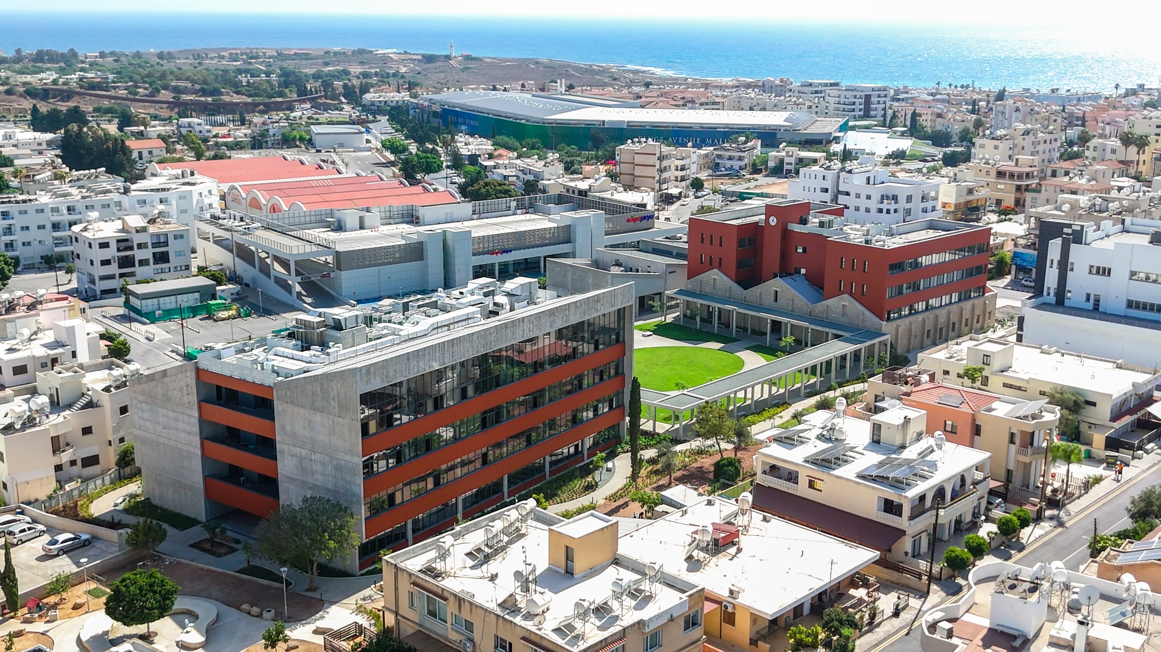
Notes:
Rector shares at high level.

