Slide 1







Staff Presentations & Q&A
Fall 2026–2027 New Faculty Orientation

Slide 2











Agenda
  Office of the Registrar – Rami Kassem & Dimitra Laoura Melkonidou
  Academics – Elizabeth Sweetman
  Facilities – Michalis Hadjiarapis
  IT – Olaf Machul
  Student Affairs – Simone Tourkomenis-Kollias
  University Outreach – Maria Kamenias
  Global Engagement – Nathalie Atallah
  Communications – Ghina Ramadan
  Administration & Events – Yiannis Anthis & Evdokia Petropoulou
  Grants – Monica Tsartsali
  Library – Christos Kotsias
  Writing Center – Ryan McDonald
  Accessibility – Georgia Polyviou
  Counseling – Anna Kafkaride
  HR/Payroll

Slide 3

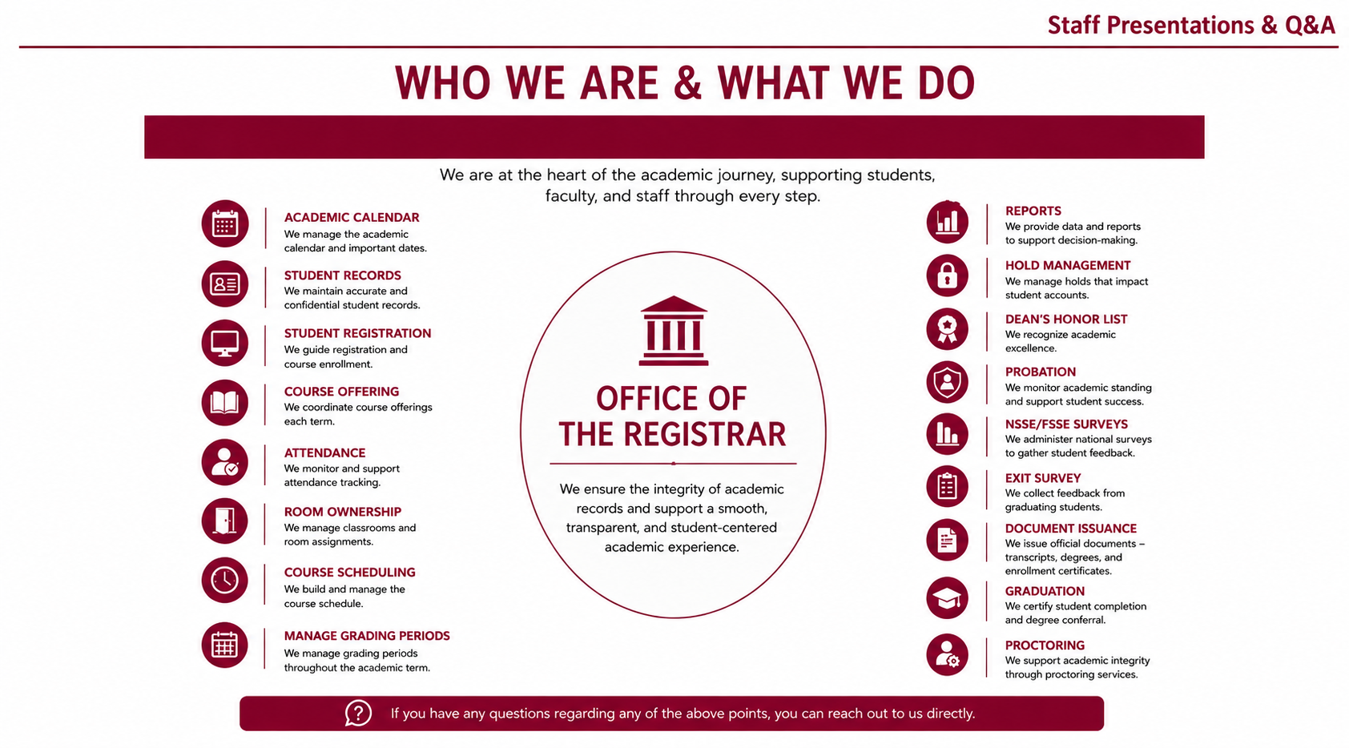

Slide 4
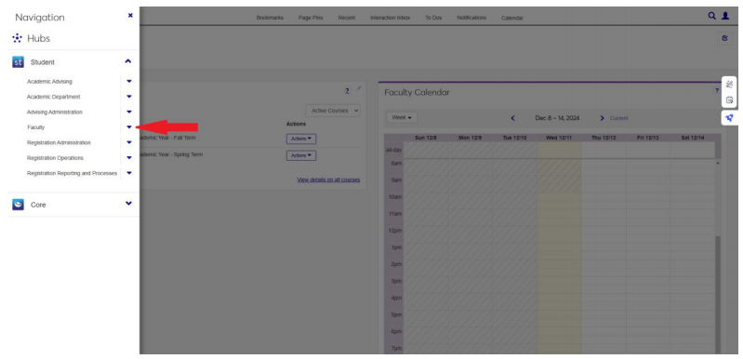
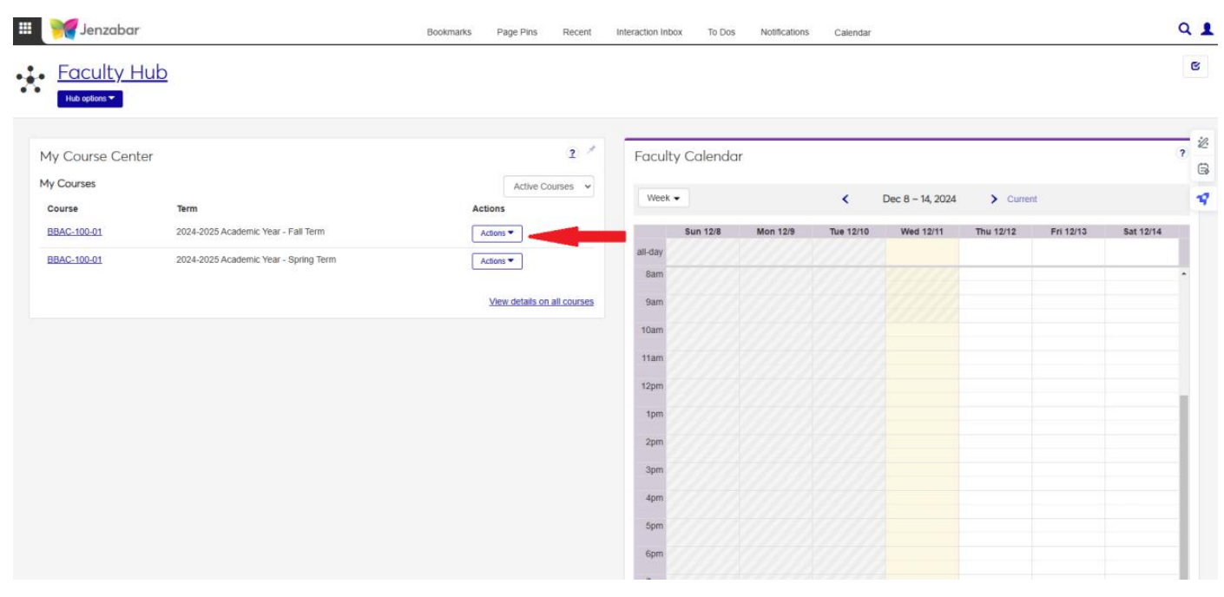
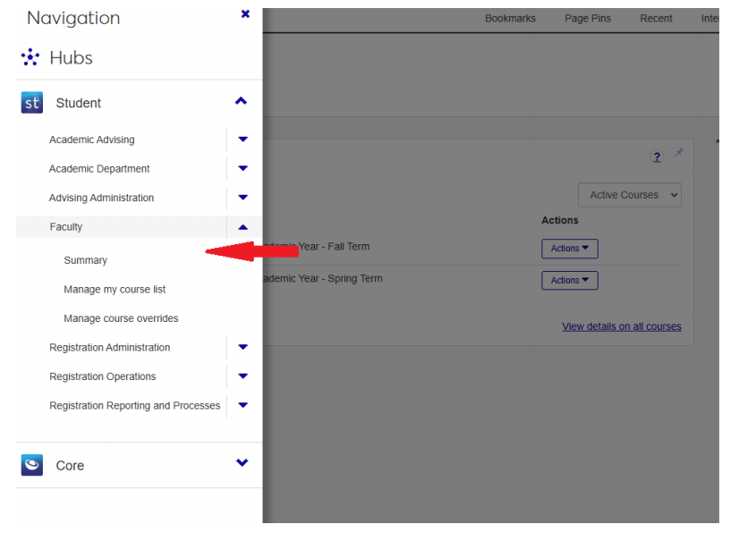
Staff Presentations & Q&A
Office of the Registrar
Entering & Submitting Final Grades

Slide 5
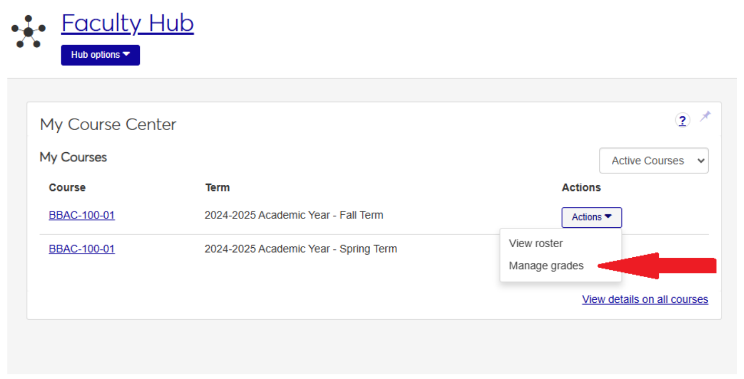
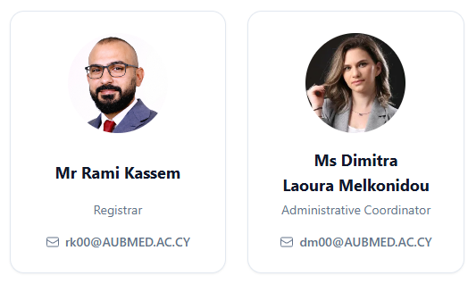
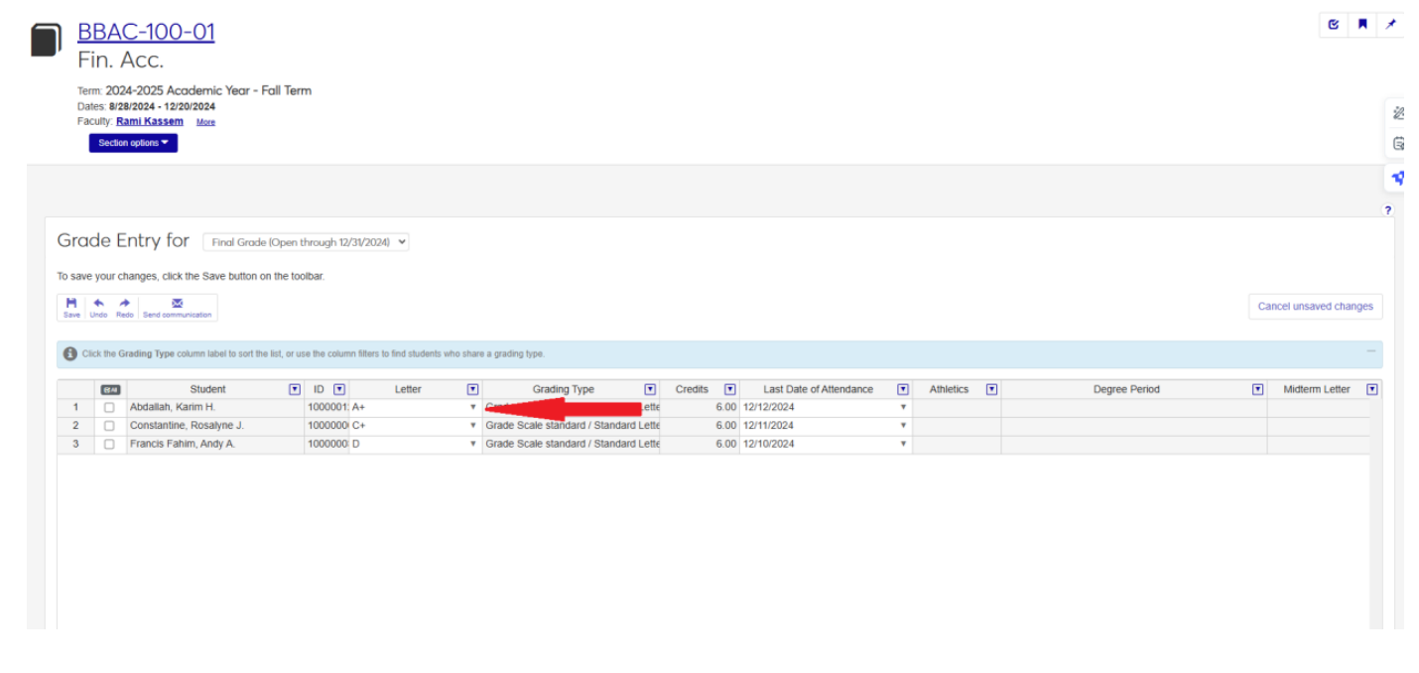
Staff Presentations & Q&A
Office of the Registrar
Contact: registrar@aubmed.ac.cy

Slide 6
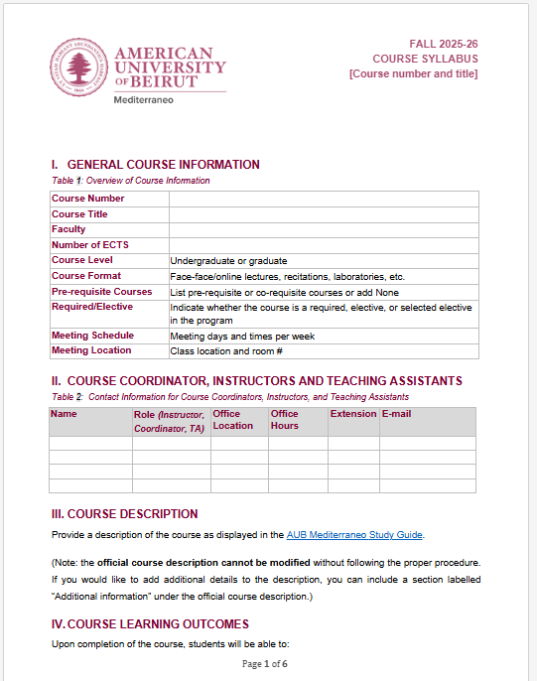
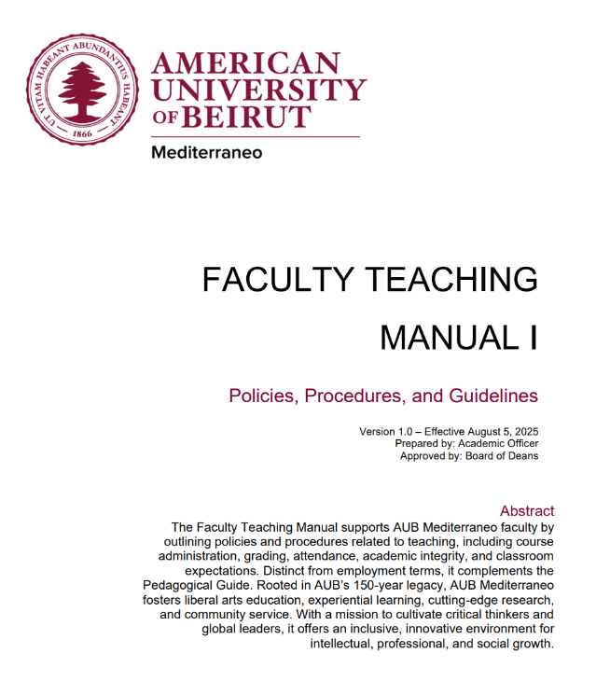

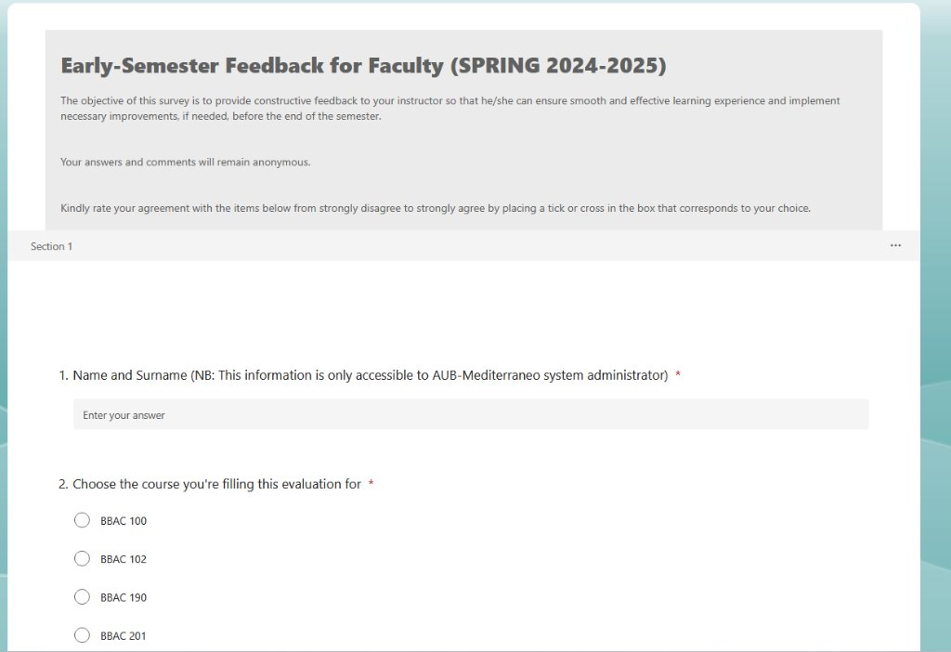





Staff Presentations & Q&A
Academics
Course documentation – syllabi, course portfolios, policy alignment, website, Study Guide/Catalogue, sample study plans
Faculty support – recruitment, resources, guidance, orientation, academic policies
Course changes & proposals – revisions, new course process
Accreditation – visits, materials, new programs, compliance
Feedback & evaluations – early-term and end-of-term Instructor Course Evaluations (ICE)
Transfers – course equivalencies for transfer students
Academic Affairs & Accreditation Manager: Elizabeth Sweetman (ES00@aubmed.ac.cy)
Academic Affairs Assistant: Loubna Talbi (LT00@aubmed.ac.cy)

Slide 7
Staff Presentations & Q&A
Facilities
Who we are: Michalis Hadjiarapis and Raphael Savva, Emanouil Papalouka.
What we do: Maintenance, Custodial, Safety and Sustainability, Groundskeeping, Renovations.
Why it matters: We keep the Campus running so you can focus on teaching and innovating in a healthy and safe space.
Contacting us: Ticketing system, email, and phone for emergencies.
Partnership: Reporting issues, respecting shared spaces, and providing feedback will result in creating an excellent learning and working environment.

Slide 8
Staff Presentations & Q&A
IT
Who we are: Olaf Machul & Chris Georgiou & Themis Sivitanides.
What we do: Classroom & Office Equipment Setups, Account Management, LMS EXAM Setups and other general troubleshooting.
Why it matters: We can make sure that all technical functionalities are running optimally therefore preventing disasters, delays or major incidents.
Contacting us: You can create a ticket by sending an email to it@aubmed.ac.cy or contact us directly on om00@aubmed.ac.cy & cg00@aubmed.ac.cy.
Partnership: All types of actions from the IT dep. should be logged on the ticketing system so we can keep a track of what has been completed, and refer to in any future occurrences.

Slide 9
Staff Presentations & Q&A
Student Affairs
Supports students in housing, health/medical, and settling into dorm/city life.
Organizes diverse activities promoting culture, recreation, well-being, team building, sports and volunteering.
Clubs & Societies → advises and supports student organizations.
Student Initiatives → supports and organizes student-led initiatives and activities.
Student Council → holds annual elections for the student body
Faculty Meetings → shares student concerns/updates.
Public Outreach → initiates and promotes the interaction between the university and local community.
Contact: osa@aubmed.ac.cy
Simone Tourkomenis-Kollias: st00@aubmed.ac.cy

Slide 10
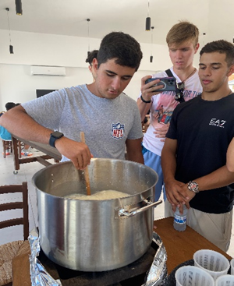
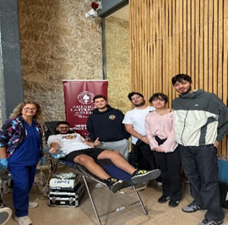
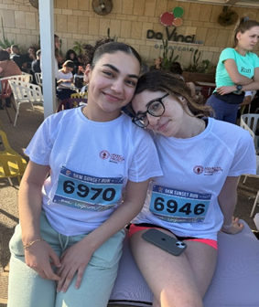
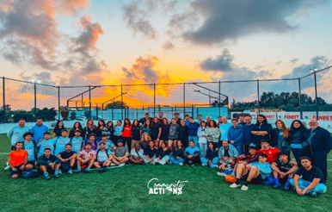
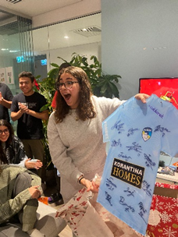
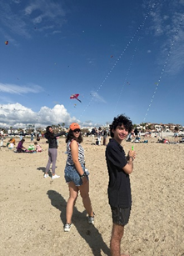
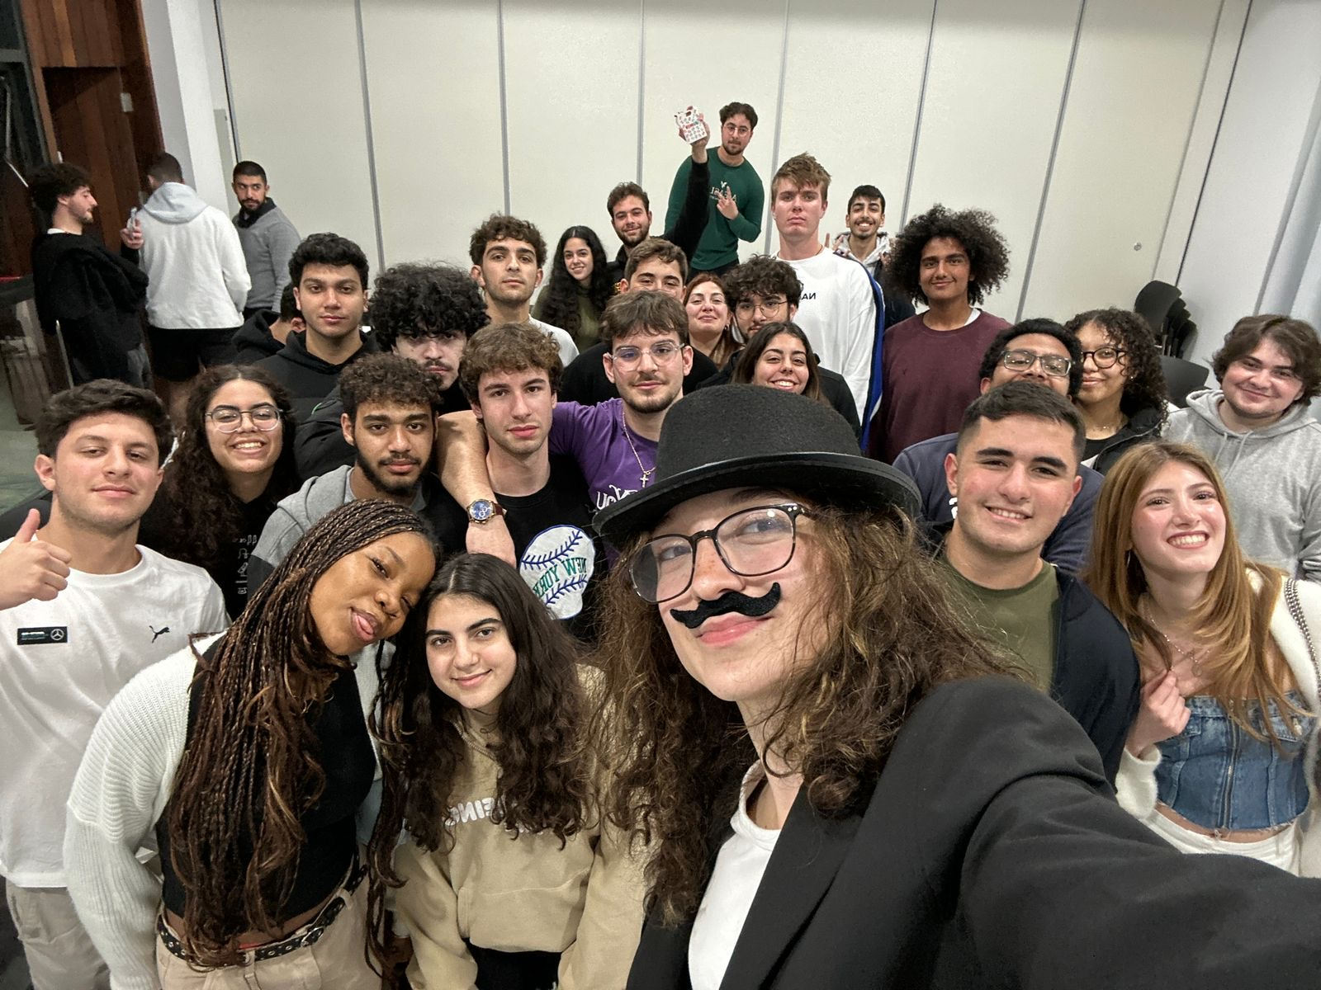
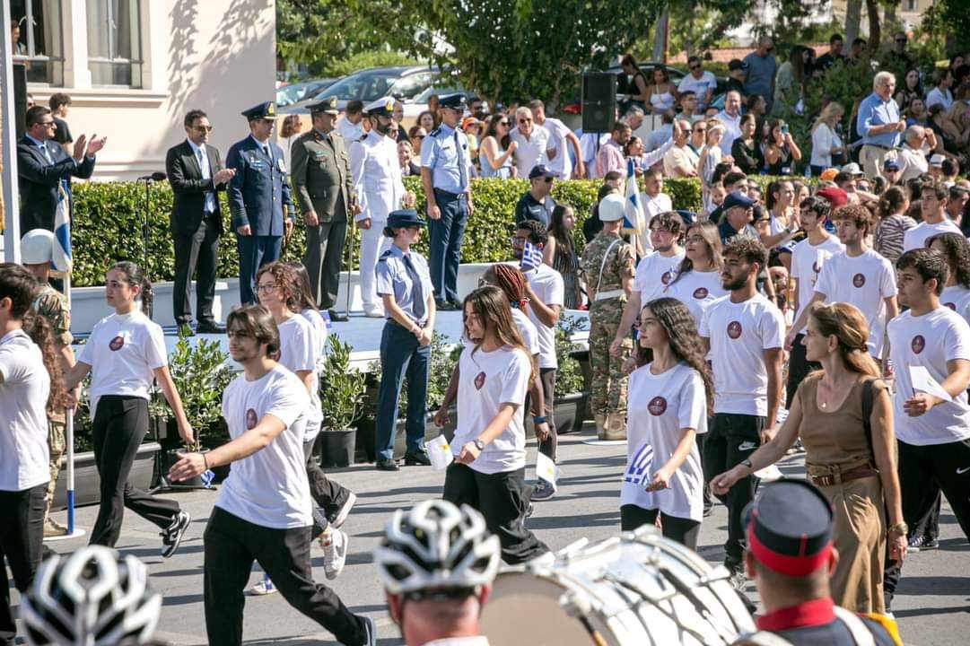
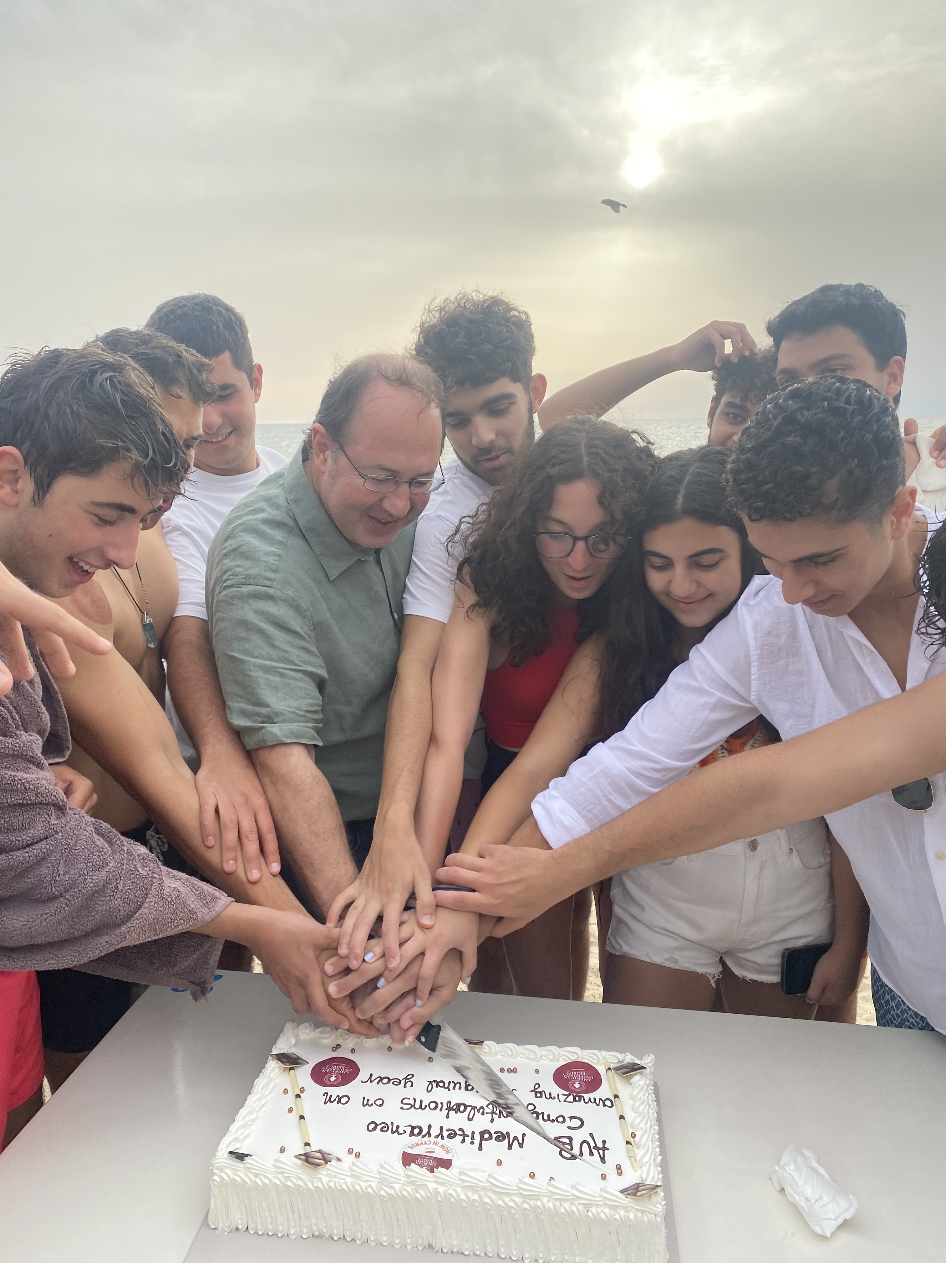
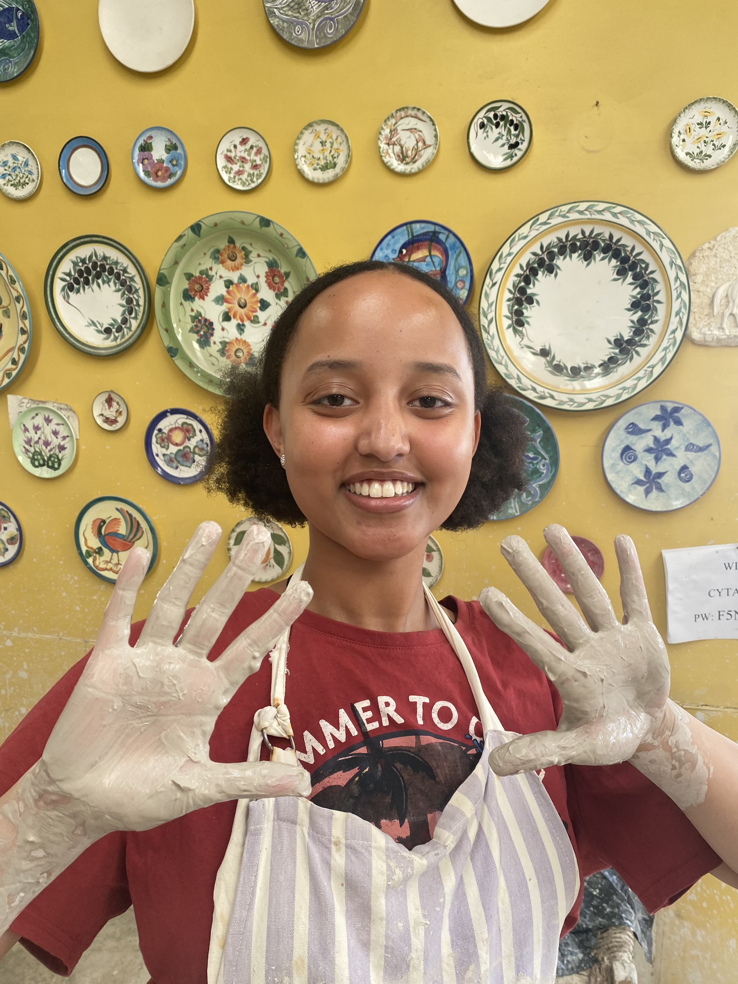
Staff Presentations & Q&A
Student Affairs

Slide 11
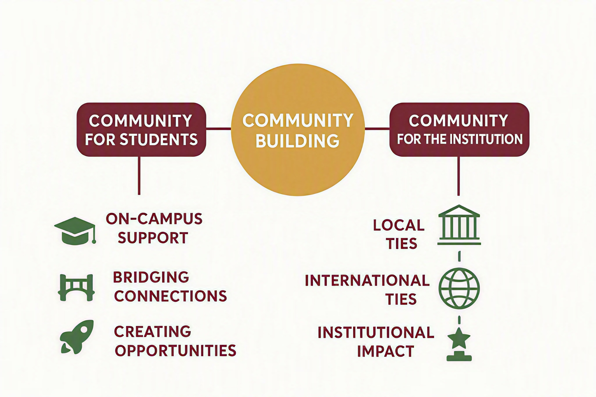
Staff Presentations & Q&A
Outreach

Slide 12
Staff Presentations & Q&A
Outreach
Career Support
Resume & cover letter review
Mock interviews
Career path exploration
Networking guidance
Job/internship search strategy
Community Engagement
Community partnership events
Cyprus Forum Pafos
Open Day
University for All
Partnerships
Employer & industry connections
Alumni network engagement
Guest speaker coordination
Internship placement partnerships
Cross-department collaboration opportunities
Maria Kamenias
mk01@aubmed.ac.cy

Slide 13

Staff Presentations & Q&A
Global Engagement
🌍 Office of International Programs
🎓Support International Students
✈️ Study Abroad & Mobility
🤝Build Global Partnerships
Nathalie Atallah
Na01@aubmed.ac.cy
oip@aubmed.ac.cy

Slide 14
Staff Presentations & Q&A
Communications
How Communications can support you:
Please reach out early.
The earlier we know, the more effectively we can support you.
News & Stories
Share research, publications, awards, faculty and student achievements, partnerships, and other updates with Communications.
Brand & Media
Use the university’s approved name, logo, and visual identity. Share public-facing materials for review and direct media inquiries to Communications.
Events & Initiatives
Involve Communications early when planning activities that may require promotion, media outreach, photography, website coverage, or social media support.
Point of Contact
Ghina Ramadan, Marketing and Communications Officer
Gr00@aubmed.ac.cy; communications@aubmed.ac.cy

Slide 15
Staff Presentations & Q&A
Administration & Events
Support with:
Campus transportation and field trips
Purchases and procurement
Guest speaker vetting (required for all on- and off-site guests)
Event support (e.g., bookings, catering, logistics)
Stationary supplies
Business trip logistics (e.g., visit to AUB, conferences)
Yiannis Anthis: ya00@aubmed.ac.cy
Evdokia Petropoulou: ep01@aubmed.ac.cy

Slide 16
Staff Presentations & Q&A
Office of Research (OOR) - Grants
Research support across the project lifecycle - from opportunity identification to compliant project close-out.
Pre-Award
Post-Award
01. Opportunity Discovery
Identification of relevant funding opportunities (Erasmus+, Horizon Europe, Interreg, Creative Europe, etc.)
Matching of consortium opportunities received with relevant researchers. (the OOR acts as the connecting link between the university and external collaborations for proposals.)
02. Proposal Development and Compliance
Supporting with proposal coordination, review, and drafting of administrative parts and horizontal WPs.
Ensuring eligibility and compliance.
Providing templates, and guidance on the review of the proposals
Supporting in the drafting of proposal budgets.
03. Award Management
Supporting the Financial Management of projects (timesheets, periodic and final financial reports).
Ensuring compliance
Supporting the requests for amendments (e.g., project duration extensions, budget amendments, etc.) and communications with the managing authority.
04. Close-out & assurance
Supporting in the preparation and compilation of data for audits and evaluations.

Slide 17
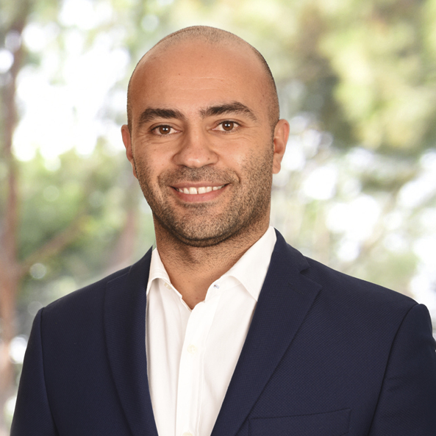
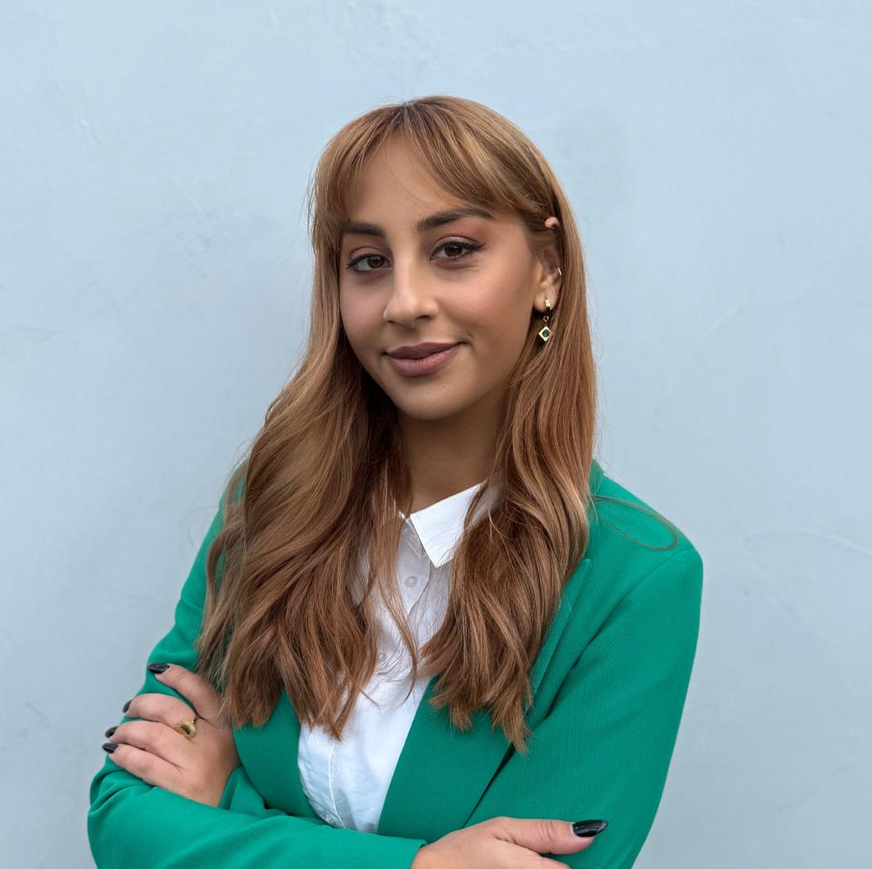
Staff Presentations & Q&A
Office of Research – Resources and contact details
More information, resources, templates, policies and training material can be found in the Moodle page here:
Section: AUB Mediterraneo - Research Resources | Research @ AUB Mediterraneo | AUB Mediterraneo
Alain Daou, Dean of the Faculty of Business, Head of the Office of Research
daou@aubmed.ac.cy
Monica Tsartsali, Grants Officer, Office of Research
mt01@aubmed.ac.cy

Slide 18
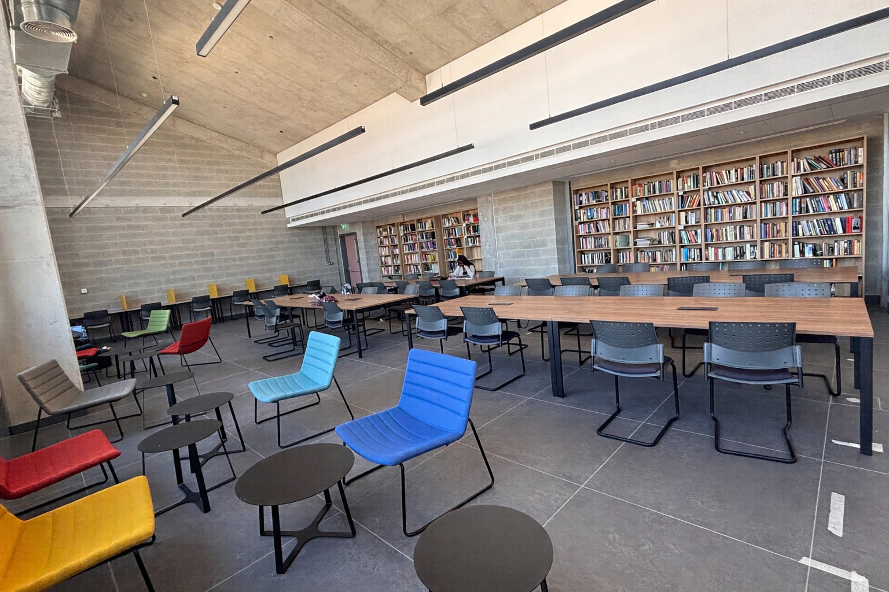
Staff Presentations & Q&A
AUB Mediterraneo Library
Physical Library
Physical library and study space on the 3rd floor of the Academic Building (launching this fall!)
~1,000 books primarily for GLA and PPE programs, and reference texts requested by faculty.
Collection expanding based on faculty and student needs.
Online Library Resources
Extensive AUB electronic library , including 400+ databases, 2.8M+ e-books, and 245K+ e-journals
Faculty can request books and other resources that are not currently available
AUB librarians provide research support, library instruction, course guides, and embedded librarian support
Key contacts (see Library page)
Local Librarian: Christos Kotsias (ck02@aubmed.ac.cy)
Teaching & Course Support: Fatme Charafeddine (AUB)
Book requests: Albert Haddad (AUB)

Slide 19
Staff Presentations & Q&A
Writing Center
Services
Student Services:
  One-on-one support, small group workshops, push-in sessions (for all writers)
    Non-evaluative, judgement free space for dialogue
  Creative/academic expression support
  Community writing events (we are open to the public)
Faculty Services:
  Conference proceedings, publications, sticky citations, reviewer feedback
  Grant proposals, concept notes
  Writing across the Disciplines (WAC), Writing Within the Disciplines (WID)
Contact: writingcenter@aubmed.ac.cy, Office 235
Ryan McDonald: rm00@aubmed.ac.cy

Slide 20
Staff Presentations & Q&A
Accessibility
Faculty Role
Implement AEO-approved accommodations
Keep all student info confidential
Contact AEO if challenges arise
Examples of Accommodations
Extra time on exams/assignments
Alternative formats or lecture recording
Flexible attendance for health needs
Inclusive Teaching
Use accessible slides/readings (headings, alt text, readable fonts)
Design with flexibility & Universal Design for Learning guidelines (UDL) principles
Contact
Georgia Polyviou, Accessible Education Officer
aeo@aubmed.ac.cy
gp00@aubmed.ac.cy

Slide 21
Staff Presentations & Q&A
Counseling
Counselling Services:
One-on-one support for psychological difficulties
Assistance with a variety of psychological issues
Safe, confidential, and non-judgmental space
Faculty Responsibilities:
Maintain strict confidentiality regarding student information
Encourage students to connect with Counselling Services if they experience mental health concerns.
Contact:
Anna Kafkaride, Student Counselor (Licensed Psychologist)
counselling@aubmed.ac.cy, ak00@aubmed.ac.cy

Slide 22
Staff Presentations & Q&A
HR/Payroll
HR and payroll services are managed by PwC, with a dedicated HR contact for AUB Mediterraneo.
Elena Masouri (PwC)
HR@aubmed.ac.cy
Contact HR/Payroll for:
Employment contracts and faculty records
Payroll and salary inquiries
Leave and absence processes
Benefits
Expense claims
Employment letters and other official documents
Other HR-related questions

Slide 23
Questions?

